Slide 1
Views and View Controllers in iOS
Vladimir Tyutin

Slide 2
View Controllers Overview

Slide 3
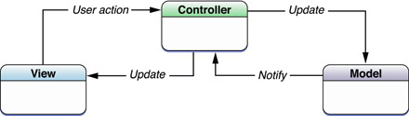
Model-View-Controller
The Model-View-Controller (MVC) design pattern assigns objects in an application one of three roles: model, view, or controller.
MVC is central to a good design for a Cocoa application.
Many objects in these applications tend to be more reusable, and their interfaces tend to be better defined.
Model objects encapsulate the data specific to an application and define the logic and computation that manipulate and process that data.
A View object is an object in an application that users can see. A major purpose of view objects is to display data from the application’s model objects and to enable the editing of that data.
A Controller object acts as an intermediary between one or more of an application’s view objects and one or more of its model objects.

Slide 4
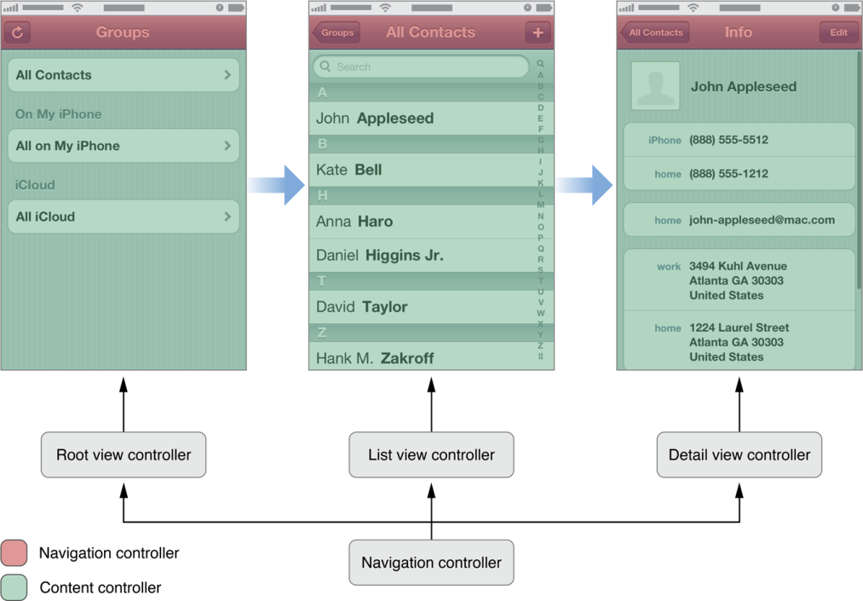
About View Controllers
View controllers are a vital link between an app’s data and its visual appearance.
Whenever an iOS app displays a user interface, the displayed content is managed by a view controller or a group of view controllers coordinating with each other.
View controllers are traditional controller objects in the Model-View-Controller (MVC) design pattern, but they also do much more.
View controllers provide many behaviors common to all iOS apps.
For some behaviors, the base class provides part of the solution and your view controller subclass implements custom code to provide the rest.

Slide 5
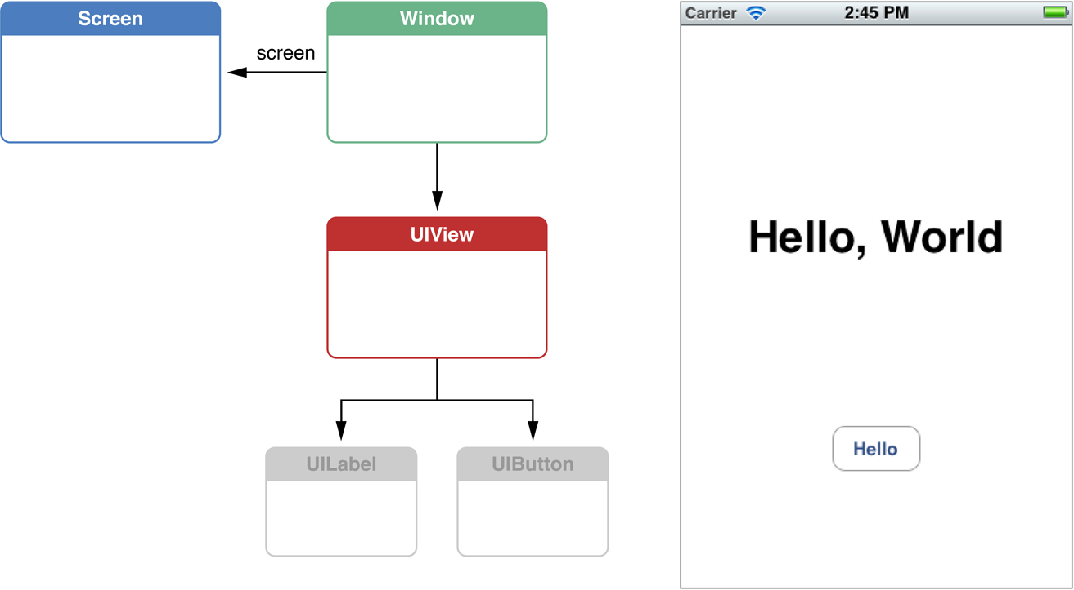
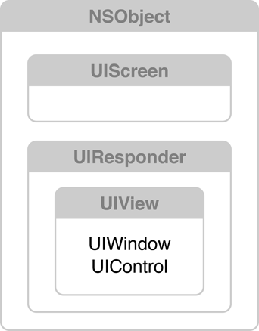
Screens, Windows, and Views Create Visual Interfaces
There are three major objects at work here:
A UIScreen object that identifies a physical screen connected to the device.
A UIWindow object that provides drawing support for the screen.
A set of UIView objects to perform the drawing. These objects are attached to the window and draw their contents when the window asks them to.
Classes (and related important classes) are defined in UIKit

Slide 6
Salient Features of Views
A view represents a user interface element. Each view covers a specific area. Within that area, it displays contents or responds to user events.
Views can be nested in a view hierarchy. Subviews are positioned and drawn relative to their superview. Thus, when the superview moves, its subviews move with it. This hierarchy makes it easy to assemble a group of related views by placing them in a common superview.
Views can animate their property values. When a change to a property value is animated, the value gradually changes over a defined period of time until it reaches the new value. Changes to multiple properties across multiple views can be coordinated in a single animation.
Animation is critically important to iOS app development. Because most apps display only a portion of their contents at one time, an animation allows the user to see when a transition occurred and where the new content came from. An instantaneous transition might confuse the user.

Slide 7
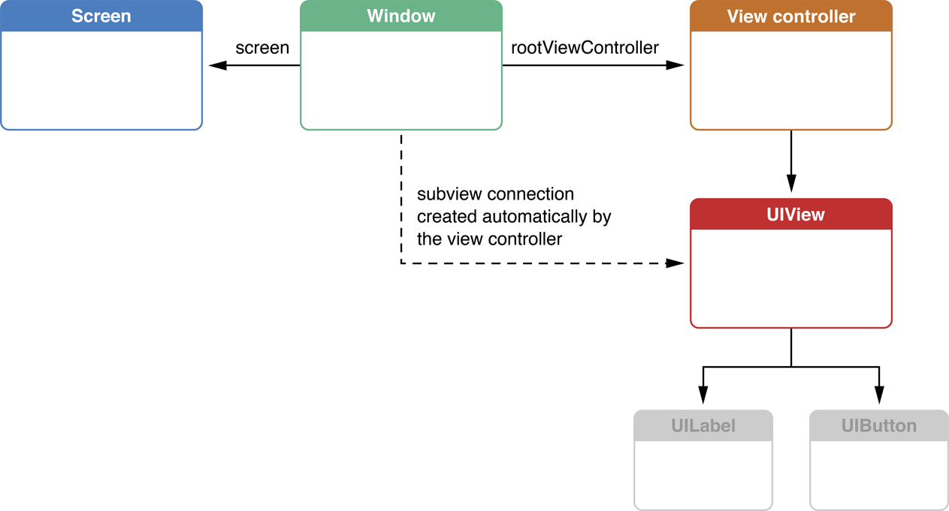
View Controllers Manage Views
You never directly assign the views to the window. Instead, you assign a view controller to the window, and the view controller automatically adds its view to the window.
Each view controller organizes and controls a view; this view is often the root view of a view hierarchy.
View controllers are controller objects in the MVC pattern, but a view controller also has specific tasks iOS expects it to perform.
These tasks are defined by the UIViewController class that all view controllers inherit from.
All view controllers perform view and resource management tasks; other responsibilities depend on how the view controller is used.

Slide 8
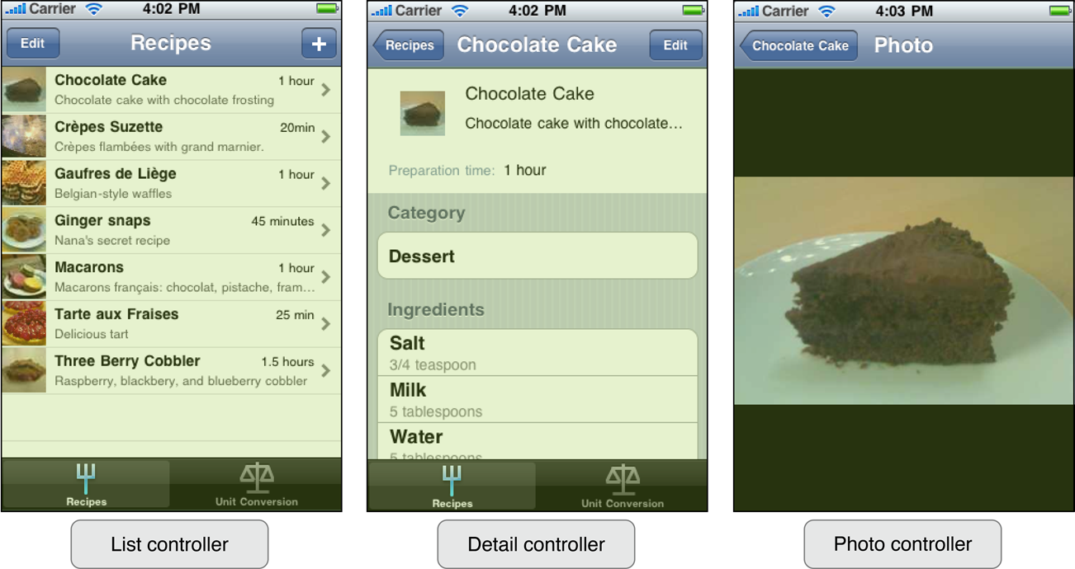
Factors Common to View Controllers
This example demonstrates a few factors common to view controllers:
Every view is controlled by only one view controller. When a view is assigned to the view controller’s view property, the view controller owns it. If the view is a subview, it might be controlled by the same view controller or a different view controller.
Each view controller interacts with a subset of your app’s data. For example, the Photo controller needs to know only the photo to be displayed.
Because each view controller provides only a subset of the user experience, the view controllers must communicate with each other to make this experience seamless. They may also communicate with other controllers, such as data controllers or document objects.

Slide 9
Content View Controllers
A content view controller presents content on the screen using a view or a group of views organized into a view hierarchy.
A content view controller usually knows about the subset of the app’s data that is relevant to the role the controller plays in the app.
Here are common examples where your app uses content view controllers:
To show data to the user
To collect data from the user
To perform a specific task
To navigate between a set of available commands or options, such as on the launch screen for a game
Content view controllers are the primary coordinating objects for your app because they know the specific details of the data and tasks your app offers the user.
Each content view controller object you create is responsible for managing all the views in a single view hierarchy. The one-to-one correspondence between a view controller and the views in its view hierarchy is the key design consideration.

Slide 10
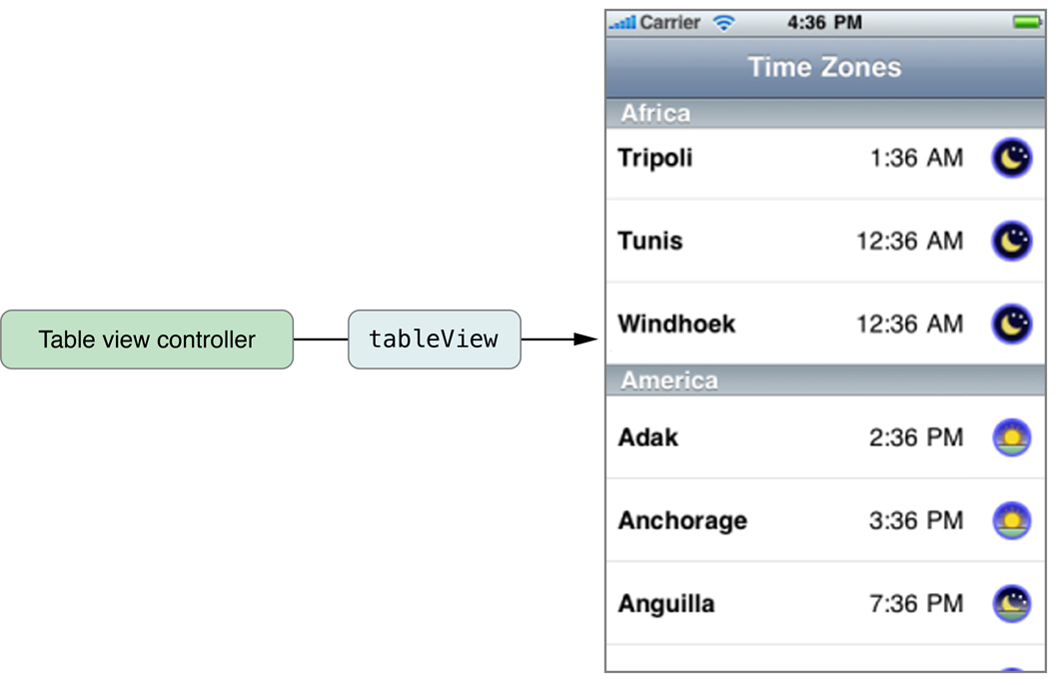
Table View Controllers
Many apps display tabular data.
For this reason, iOS provides a built-in subclass of the UIViewController class designed specifically for managing tabular data.
UITableViewController manages a table view and adds support for many standard table-related behaviors such as selection management, row editing, and table configuration.
This additional support is there to minimize the amount of code you must write to create and initialize a table-based interface.
You can also subclass UITableViewController to add other custom behaviors.

Slide 11
Container View Controllers
A container view controller contains content owned by other view controllers. These other view controllers are explicitly assigned to the container view controller as its children.
Each type of container view controller establishes a user interface that its children operate in. The visual presentation of this user interface and the design it imposes on its children can vary widely between different types of containers. For example, here are some ways that different container view controllers may distinguish themselves:
A container provides its own API to manage its children.
A container decides whether the children have a relationship between them and what that relationship is.
A container manages a view hierarchy just as other view controllers do. A container can also add the views of any of its children into its view hierarchy. The container decides when such a view is added and how it should be sized to fit the container’s view hierarchy, but otherwise the child view controller remains responsible for the view and its subviews.
A container might impose specific design considerations on its children. For example, a container might limit its children to certain view controller classes, or it might expect those controllers to provide additional content needed to configure the container’s views.

Slide 12
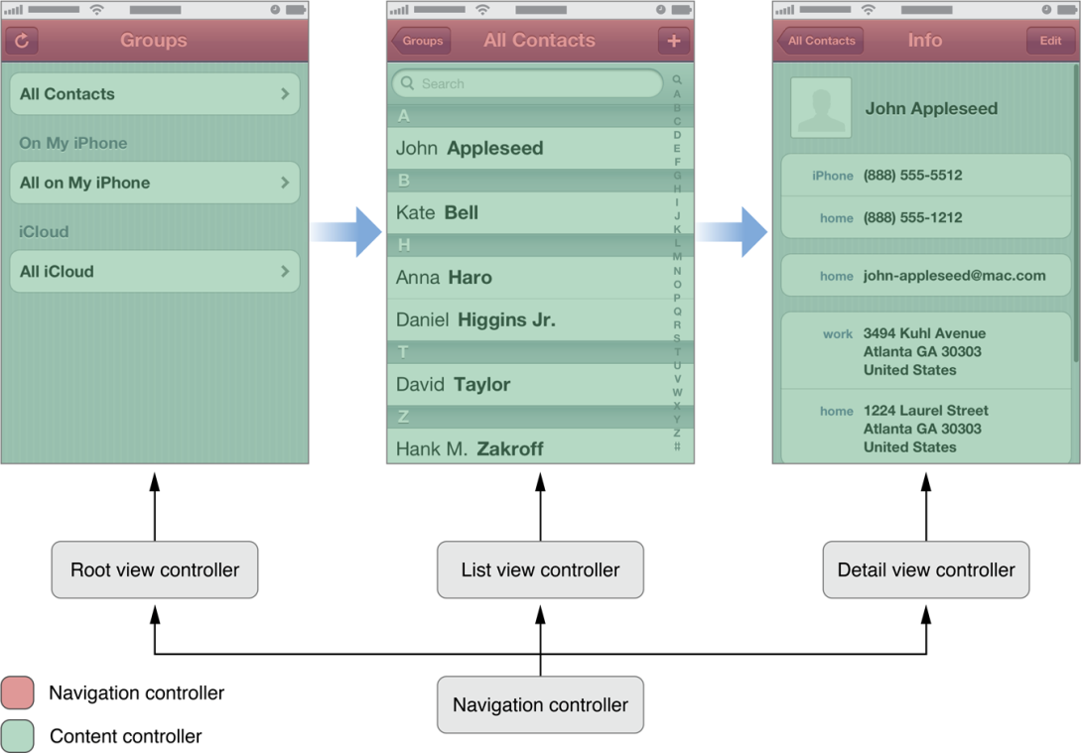
Navigation Controllers
A navigation controller presents data that is organized hierarchically and is an instance of the UINavigationController class.
The methods of this class provide support for managing a stack-based collection of content view controllers.
This stack represents the path taken by the user through the hierarchical data, with the bottom of the stack reflecting the starting point and the top of the stack reflecting the user’s current position in the data.
Although a navigation controller’s primary job is to manage its child view controllers, it also manages a few views.
Specifically, it manages a navigation bar (that displays information about the user’s current location in the data hierarchy), a button (for navigating back to previous screens), and any custom controls the current view controller needs.

Slide 13
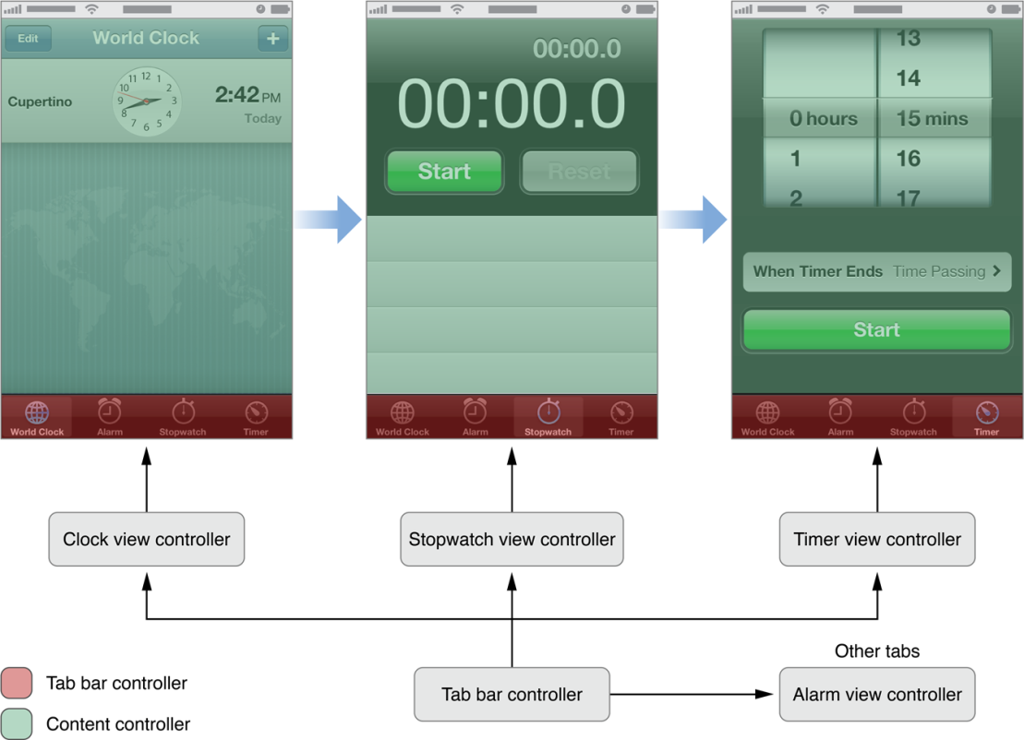
Tab Bar Controllers
A tab bar controller is a container view controller that you use to divide your app into two or more distinct modes of operation.
A tab bar controller is an instance of the UITabBarController class.
The tab bar has multiple tabs, each represented by a child view controller. Selecting a tab causes the tab bar controller to display the associated view controller’s view on the screen.
You use tab bar controllers when your app either presents different types of data or presents the same data in different ways.

Slide 14
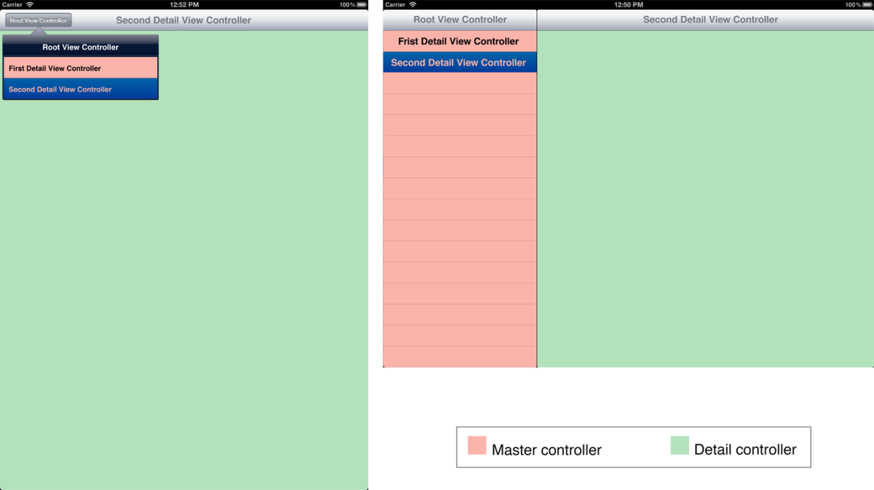
Split View Controllers
A split view controller divides the screen into multiple parts, each of which can be updated separately.
The appearance of a split view controller may vary depending on its orientation.
A split view controller is an instance of the UISplitViewController class.
The contents of a split view interface are derived from two child view controllers.
Split view controllers are supported on iPad only and are designed to help you take advantage of the larger screen of that device.
They are the preferred way to implement master-detail interfaces in iPad apps.

Slide 15
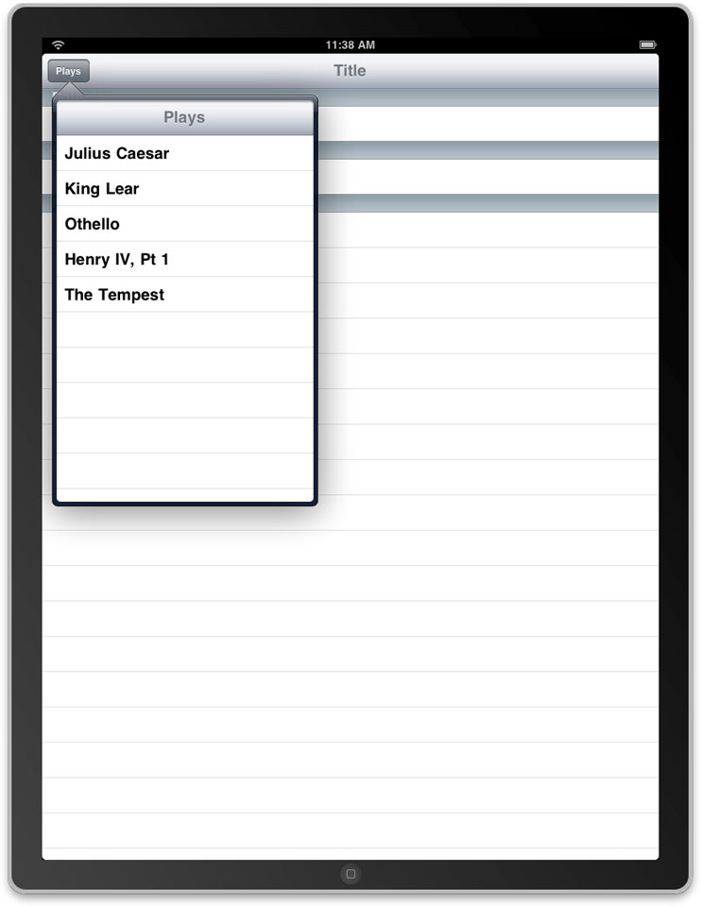
Popover Controllers
In an iPad app, you can use popover controllers (UIPopoverController) to implement popovers in your own app.
A popover controller is not actually a container; it does not inherent from UIViewController at all.
But, in practice, a popover controller is similar to a container, so you apply the same programming principles when you use them.

Slide 16
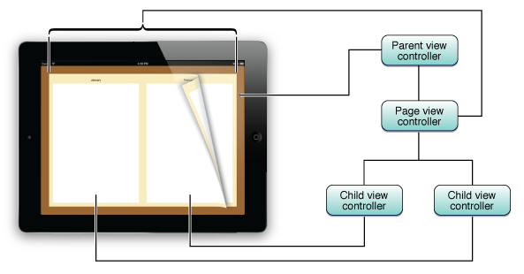
Page View Controllers
A page view controller is a container view controller used to implement a page layout.
That layout allows users to flip between discrete pages of content as if it were a book.
A page view controller is an instance of the UIPageViewController class.
Each content page is provided by a content view controller.
The page view controller manages the transitions between pages.
When new pages are required, the page view controller calls an associated data source to retrieve a view controller for the next page.

Slide 17
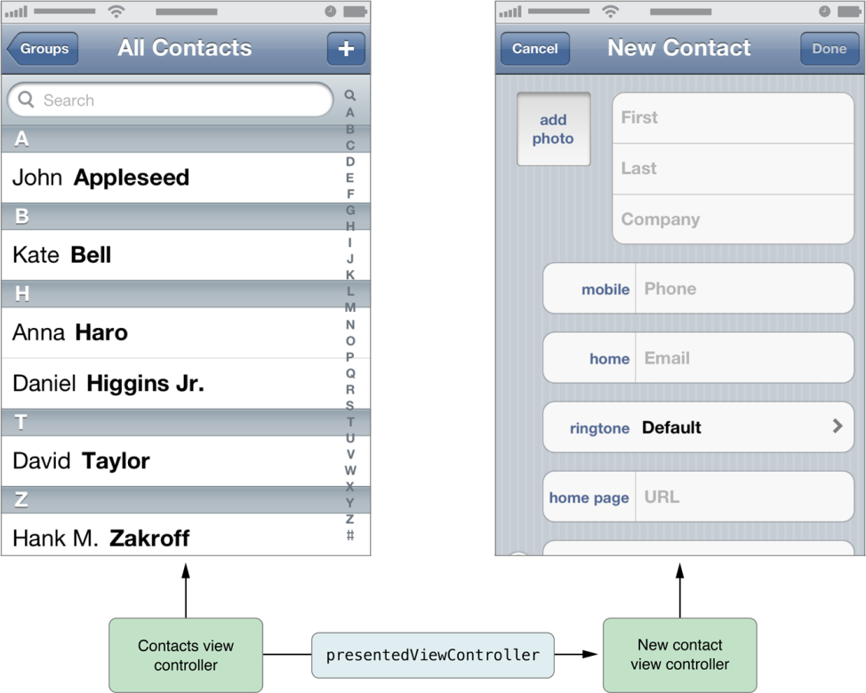
Modal Mode Container
For a view controller’s contents to be visible to the user, it must be associated with a window. There are many ways you can do this in your app:
Make the view controller a window’s root view controller.
Make the view controller a child of a container.
Show the view controller in a popover control.
Present it from another view controller.
A presented view controller isn’t a specific type of view controller—the presented view controller can be either a content or a container view controller with an attached content view controller.
In practice, the content view controller is designed specifically to be presented by another controller, so it can be useful to think of it as a variant of a content view controller.
When presenting a view controller, one view controller determines how much of the screen is used to present the view controller.

Slide 18
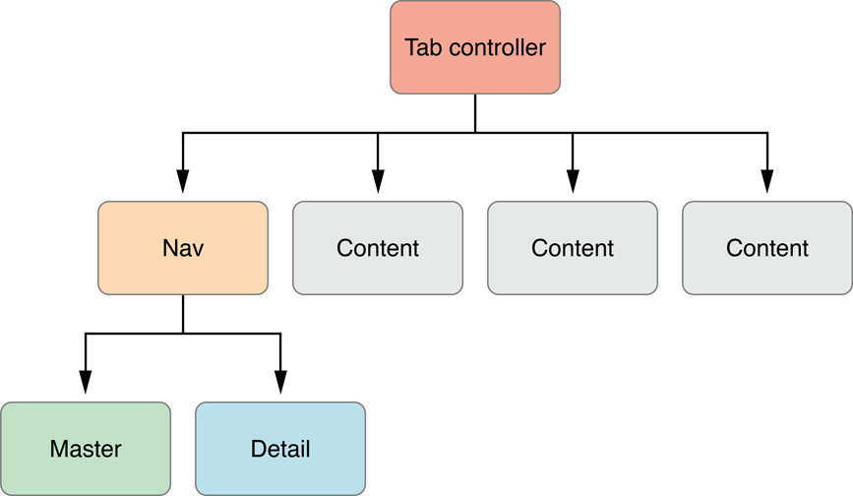
Parent-Child Relationships Represent Containment
A view controller hierarchy starts with a single parent, the root view controller of a window. If that view controller is a container, it may have children that provide content. Those controllers, in turn, may also be containers with children of their own
The area each view controller fills is determined by its parent. The root view controller’s area is determined by the window.
the tab view controller gets its size from the window.
It reserves space for its tab bar and gives the remainder of the space to its children.
If the navigation controller were the control displayed right now, it reserves space for its navigation bar and hands the rest to its content controller.
At each step, the child view controller’s view is resized by the parent and placed into the parent’s view hierarchy.

Slide 19
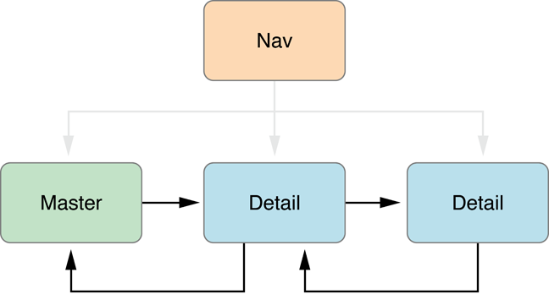
Sibling Relationships Represent Peers Inside a Container
The kind of container defines the relationships (if any exists) shared by its children. For example, compare the tab view controller and navigation controller.
In a tab view controller, the tabs represent distinct screens of content; tab bar controllers do not define a relationship between its children, although your app can choose to do so.
In a navigation controller, siblings display related views arranged in a stack. Siblings usually share a connection with adjacent siblings.
The first child, the master, shows the available content without showing all of the details.
When an item is selected, it pushes a new sibling onto the navigation controller so that the user can see the additional details.
Similarly, if the user needs to see more details, this sibling can push another view controller that shows the most detailed content available.
When siblings have a well defined relationship as in this example, they often coordinate with each other, either directly or through the container controller.

Slide 20
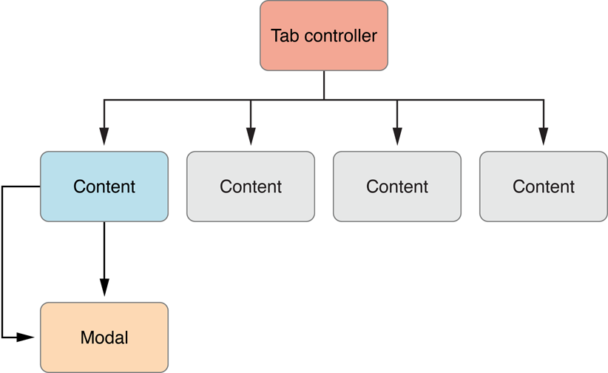
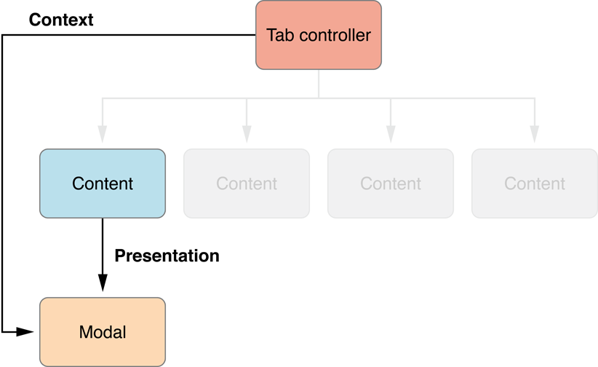
Presentation Represents a Transient Display of Another Interface
A view controller presents another view controller when it wants that view controller to perform a task.
The presenting view controller is in charge of this behavior. It configures the presented view controller, receives information from it, and eventually dismisses it.
However, while it is being presented, the presented view controller’s view is temporarily added to the window’s view hierarchy.
When a view controller is presented, the portion of the screen that it covers is defined by a presentation context provided to it by another view controller.
The view controller that provides the presentation context does not need be the same view controller that presented it.
The view controller was presented by the tab controller. So the presented view controller uses the entire area owned by the tab view controller.

Slide 21
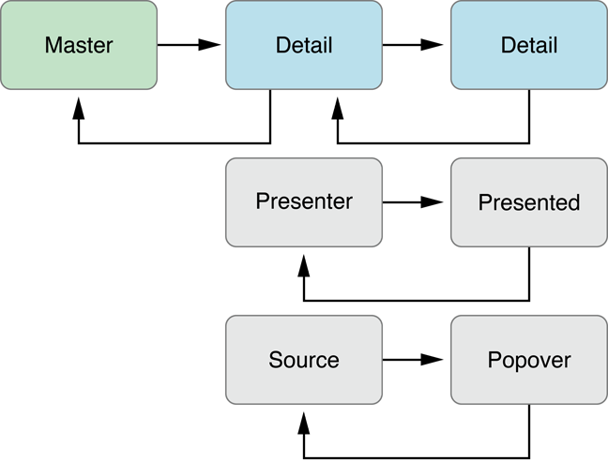
Control Flow Represents Overall Coordination Between Content Controllers
Usually, a view controller is instantiated because of actions in another view controller.
The first view controller, known as the source view controller directs the second view controller, the destination view controller.
In the figure:
A child of a navigation controller pushes another child onto the navigation stack.
A view controller presents another view controller.
A view controller displays another view controller in a popover.
The control flow at each link in this chain is defined by the destination view controller. The source view controller uses the conventions provided by the destination view controller.
The destination view controller provides properties used to configure its data and presentation.
If the destination view controller needs to communicate with view controllers preceding it in the chain, it uses delegation. When the source view controller configures the destination view controller’s other properties, it is also expected to provide an object that implements the delegate’s protocol.

Slide 22
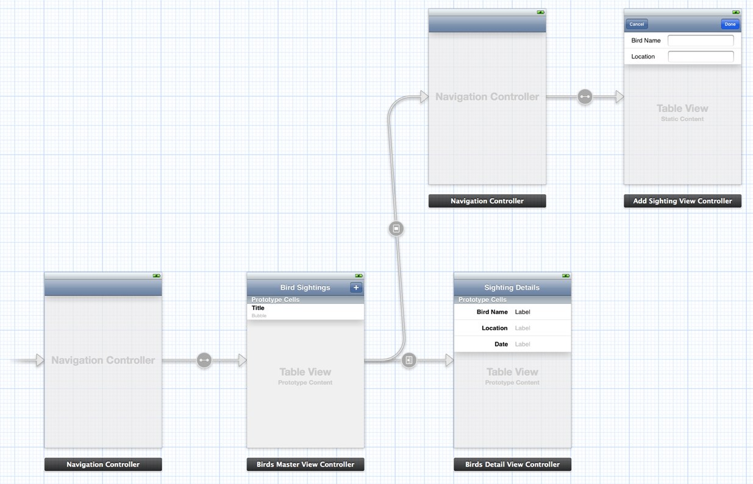
Use Storyboards to Design Your User Interface
A scene represents an onscreen content area that is managed by a view controller.
You create relationships between scenes in the same storyboard.
Two important kinds of relationships exist:
Containment represents a parent-child relationship between two scenes.
A segue represents a visual transition from one scene to another.
Different kinds of segues provide the common transitions needed between two different view controllers:
A push segue pushes the destination view controller onto a navigation controller’s stack.
A modal segue presents the destination view controller.
A popover segue displays the destination view controller in a popover.
A custom segue allows you to design your own transition to display the destination view controller.

Slide 23
Navigation Controller in Details

Slide 24
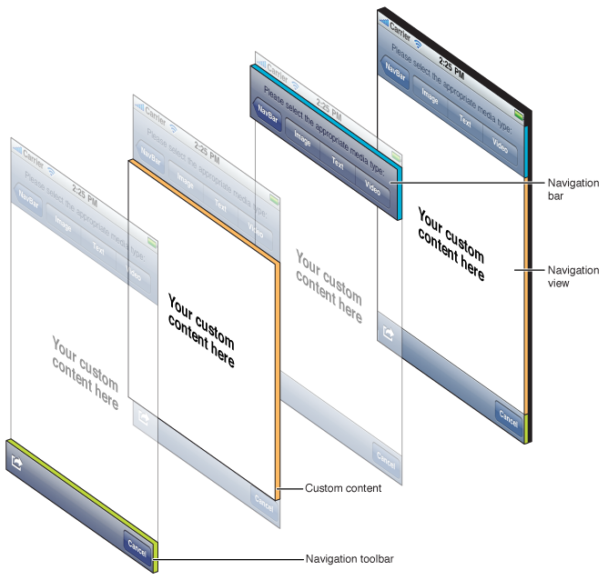
Anatomy of a Navigation Interface
A navigation controller’s primary job is to manage the presentation of your content view controllers, and it is also responsible for presenting some custom views of its own.
Specifically, it presents a navigation bar, which contains a back button and some buttons you can customize.
A navigation controller can also optionally present a navigation toolbar view and populate it with custom buttons.
Although the navigation bar and toolbar are customizable views, you must never modify the views in the navigation hierarchy directly. The only way to customize these views is through methods of the UINavigationController and UIViewController classes.

Slide 25
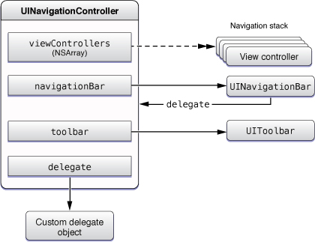
The Objects of a Navigation Interface
A navigation controller uses several objects to implement the navigation interface.
You are responsible for providing some of these objects and the rest are created by the navigation controller itself.
Specifically, you are responsible for providing the view controllers with the content you want to present.
If you want to respond to notifications from the navigation controller, you can also provide a delegate object.
The navigation controller creates the views—such as the navigation bar and toolbar—that are used for the navigation interface, and it is responsible for managing those views.

Slide 26
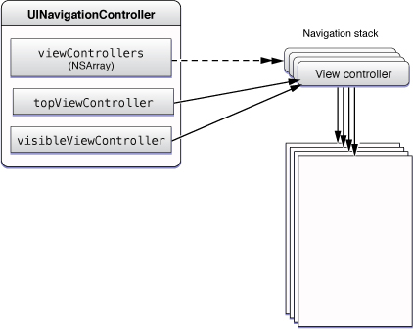
The Navigation Stack
You can modify the delegate and the other view controllers on the navigation stack.
The navigation stack is a last-in, first-out collection of custom view controller objects that is managed by the navigation controller.
The first item added to the stack becomes the root view controller and is never popped off the stack.
Additional items can be added to the stack using the methods of the UINavigationController class.
Note that the top view controller and the visible view controller are not necessarily the same. For example, if you present a view controller modally.

Slide 27
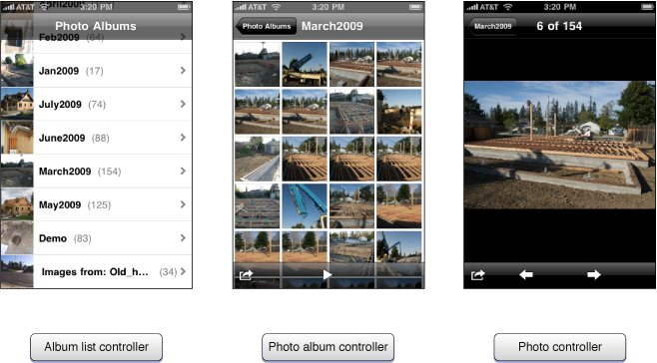
Defining the Content View Controllers for a Navigation Interface
Every navigation interface has one level of data that represents the root level.
This level is the starting point of your interface.
To implement a navigation interface, you must decide what data to present at each level of your data hierarchy.
For each level, you must provide a content view controller to manage and present the data at that level.
Each content view controller must provide a way for the user to navigate to the next level of the data hierarchy, except for view controllers managing leaf data.
A view controller that displays a list of items can use taps in a given table cell to display the next level of data.

Slide 28
Creating a Navigation Interface Using a Storyboard
To create a navigation controller in a storyboard, do the following:
Drag a navigation controller from the library.
Interface Builder creates a navigation controller and a view controller, and it creates a relationship between them. This relationship identifies the newly created view controller as the root view controller of the navigation controller.
Display it as the first view controller by selecting the option Is Initial View Controller in the Attributes inspector (or present the view controller in your user interface in another way.)

Slide 29
Creating a Navigation Interface Programmatically
When creating a navigation controller, you must do the following:
Create the root view controller for the navigation interface. This object is the top-level view controller in the navigation stack. The navigation bar displays no back button when its view is displayed and the view controller cannot be popped from the navigation stack.
Create the navigation controller, initializing it using the initWithRootViewController: method.
Set the navigation controller as the root view controller of your window (or otherwise present it in your interface).
-(void)applicationDidFinishLaunching:(UIApplication *)application{
UIViewController *myViewController = [[MyViewController alloc] init];
navigationController = [[UINavigationController alloc] initWithRootViewController:myViewController];
window = [[UIWindow alloc] initWithFrame:[[UIScreen mainScreen] bounds]];
window.rootViewController = navigationController;
[window makeKeyAndVisible];
}

Slide 30
Modifying the Navigation Stack
Scenario | Description
Display the next level of hierarchical data. | pushViewController:animated: method to push a new view controller onto the navigation stack.
Back up one level in the hierarchy. | Remove the topmost view controller programmatically using the popViewControllerAnimated: method.
Restore the navigation stack to a previous state. | When your app launches, you can use the setViewControllers:animated: method to restore the navigation controller to a previous state.
Return the user to the root view controller. | To return to the top of your navigation interface, use the popToRootViewControllerAnimated: method.
Back up an arbitrary number of levels in the hierarchy. | To back up more than one level at a time, use the popToViewController:animated: method.

Slide 31
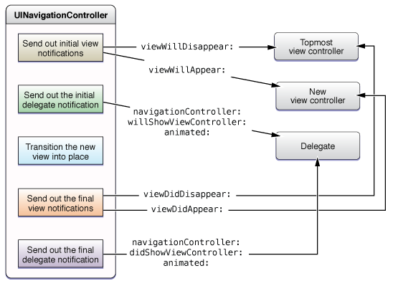
Monitoring Changes to the Navigation Stack
Whenever you push or pop a view controller, the navigation controller sends messages to the affected view controllers.
The navigation controller also sends messages to its delegate when its stack changes.
If you push or pop multiple view controllers at once, only the view controller that was visible and the view controller that is about to become visible have the method called.

Slide 32
TabBar Controllers in Details

Slide 33
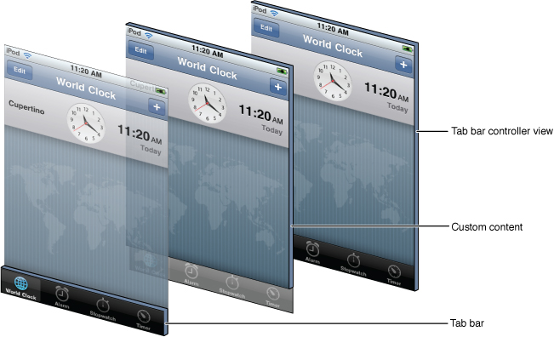
Anatomy of a Tab Bar Interface
A tab bar interface is useful in situations where you want to provide different perspectives on the same set of data or in situations where you want to organize your app along functional lines.
The key component of a tab bar interface is the presence of a tab bar view along the bottom of the screen.
This view is used to initiate the navigation between your app’s different modes and can also convey information about the state of each mode.
The manager for a tab bar interface is a tab bar controller object. The tab bar controller creates and manages the tab bar view and also manages the view controllers that provide the content view for each mode.
Each content view controller is designated as the view controller for one of the tabs in the tab bar view. When a tab is tapped by the user, the tab bar controller object selects the tab and displays the view associated with the corresponding content view controller.

Slide 34
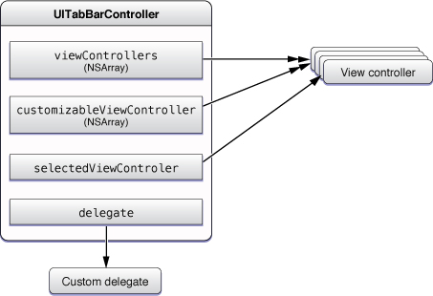
The Objects of a Tab Bar Interface
A standard tab bar interface consists of the following objects:
A UITabBarController object
One content view controller object for each tab
An optional delegate object
If you add more than five items to the viewControllers property, the tab bar controller automatically inserts a special view controller (called the More view controller) to handle the display of the additional items.
The More view controller provides a custom interface that lists the additional view controllers in a table, which can expand to accommodate any number of view controllers.
The More view controller cannot be customized or selected and does not appear in any of the view controller lists managed by the tab bar controller.

Slide 35
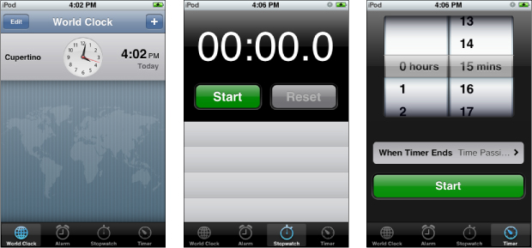
Defining the Content View Controllers for a Tab Bar Interface
Because each mode of a tab bar interface is separate from all other modes, the view controller for each tab defines the content for that tab.
Thus, the view controller you choose for each tab should reflect the needs of that particular mode of operation.
If you need to present a relatively rich set of data, you could install a navigation controller to manage the navigation through that data.
If the data being presented is simpler, you could install a content view controller with a single view.
The tab bar controller handles all of the interactions associated with presenting the content view controllers, so there is very little you have to do with regard to managing tabs or the view controllers in them. Once displayed, your content view controllers should simply focus on presenting their content.

Slide 36
Creating a Tab Bar Interface Using a Storyboard
To create a tab bar controller in a storyboard, do the following:
Drag a tab bar controller from the library.
Interface Builder creates a tab bar controller and two view controllers, and it creates relationships between them. These relationships identify each of the newly created view controllers as the view controller for one tab of the tab bar controller.
Display it as the first view controller by selecting the option Is Initial View Controller in the Attributes inspector (or present the view controller in your user interface in another way.)

Slide 37
Creating a Navigation Interface Programmatically
The steps for creating a tab bar interface are as follows:
Create a new UITabBarController object.
Create a content view controller for each tab.
Add the view controllers to an array and assign that array to your tab bar controller’s viewControllers property.
Set the tab bar controller as the root view controller of your window (or otherwise present it in your interface).
- (void)applicationDidFinishLaunching:(UIApplication *)application {
tabBarController = [[UITabBarController alloc] init];
MyViewController* vc1 = [[MyViewController alloc] init];
MyOtherViewController* vc2 = [[MyOtherViewController alloc] init];
NSArray* controllers = [NSArray arrayWithObjects:vc1, vc2, nil];
tabBarController.viewControllers = controllers;
window.rootViewController = tabBarController;
}

Slide 38
Creating a Tab Bar Item Programmatically
For each content view controller in your tab bar interface, you must provide a UITabBarItem object with the image and text to be displayed in the corresponding tab.
You can associate tab bar items with your view controllers at any time before displaying your tab bar interface.
You do this by assigning the tab bar item to the tabBarItem property of the corresponding view controller.
The recommended time to create a tab bar item is during the initialization of the view controller itself, but this is typically feasible only for custom view controllers.
You can also create and initialize the view controller object, create the tab bar item, and then make the association.
UIImage* anImage = [UIImage imageNamed:@"MyViewControllerImage.png"];
UITabBarItem* theItem = [[UITabBarItem alloc] initWithTitle:@"Home" image:anImage tag:0];

Slide 39
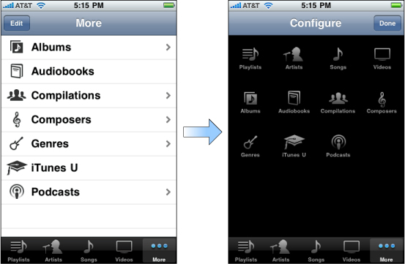
Preventing the Customization of Tabs
The More view controller provides built-in support for the user to modify the items displayed in the tab bar.
When the user taps the Edit button in the upper-left corner of this screen, the More controller automatically displays the configuration screen shown on the right.
From this screen, the user can replace the contents of the tab bar by dragging new items to it.
There may be situations where you might not want the user to remove specific tabs from the tab bar or place specific tabs on the tab bar.
In these situations, you can assign an array of view controller objects to the customizableViewControllers property.
This array should contain the subset of view controllers that it is all right to rearrange.
View controllers not in the array are not displayed on the configuration screen and cannot be removed from the tab bar if they are already there.

Slide 40
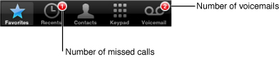
Changing a Tab’s Badge
To call attention to a specific tab, perhaps because there is new content on that tab for the user to look at, you can use a badge.
A badge is a small red marker displayed in the corner of the tab. Inside the badge is some custom text that you provide. Typically, badges contain numerical values reflecting the number of new items available on the tab, but you can also specify very short character strings too.
To assign a badge to a tab, assign a non-nil value to the badgeValue property of the corresponding tab bar item.
if (numberOfNewItems == 0)
self.tabBarItem.badgeValue = nil;
else
self.tabBarItem.badgeValue = [NSString stringWithFormat:@"%d", numberOfNewItems];

Slide 41
Page View Controllers in Details

Slide 42
Anatomy of a Page View Controller Interface
A page view controller has a single view in which it hosts your content.
The UI provided by a page view controller is visible when the user is turning the page.
The page view controller applies a page curl to its view controler’s view, providing the visual appearance of a page being turned.
The navigation provided by a page view controller is a linear series of pages.
It is well suited for presenting content that is accessed in a linear fashion, such as the text of a novel, and for presenting content that has natural page breaks, such as a calendar.
For content that the user needs to access in a nonlinear fashion, such as a reference book, you are responsible for providing the navigation logic and UI.

Slide 43
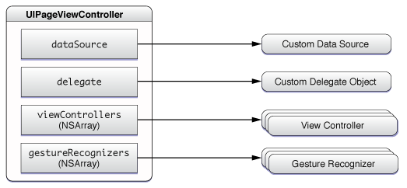
The Objects of a Page View Controller Interface
A page view interface consists of the following objects:
An optional delegate
An optional data source
An array of the current view controllers
An array of gesture recognizers
The data source provides view controllers on demand.
The delegate provides methods that are called in response to gesture-based navigation and orientation changes.
The array of view controllers contains the content view controllers that are currently being displayed. The number of items in this array varies depending on the options passed to the page view controller.
The array of gesture recognizers is populated only if a data source is set. These gesture recognizers let the user turn pages by tapping, flicking, or dragging.

Slide 44
Creating a Page View Controller Interface Using a Storyboard
The Page-Based Application Xcode template creates a new project with a page view controller as the initial scene.
To add a page view controller to an existing storyboard, do the following:
Drag a page view controller out of the library. Add a page view controller scene to your storyboard.
In the Attributes inspector, set up the appropriate options.
Optionally, set a delegate, a data source, or both by connecting the corresponding outlets.
Display it as the first view controller by selecting the option Is Initial View Controller in the Attributes inspector (or present the view controller in your user interface in another way.)

Slide 45
Creating a Page View Controller Interface Programmatically
To create a page view controller programmatically:
Allocate and initialize a page view controller using the initWithTransitionStyle:navigationOrientation:options: method.
Optionally, set a delegate, a data source, or both.
Set the initial content view controllers.
Present the page view controller’s view on the screen.
NSDictionary * options = [NSDictionary dictionaryWithObject: [NSNumber numberWithInt:UIPageViewControllerSpineLocationMid] forKey:UIPageViewControllerOptionSpineLocationKey];
UIPageViewController *pageViewController = [[UIPageViewController alloc]
initWithTransitionStyle:UIPageViewControllerTransitionStylePageCurl
navigationOrientation:UIPageViewControllerNavigationOrientationHorizontal options:options];

Slide 46
Split View Controller in Details

Slide 47
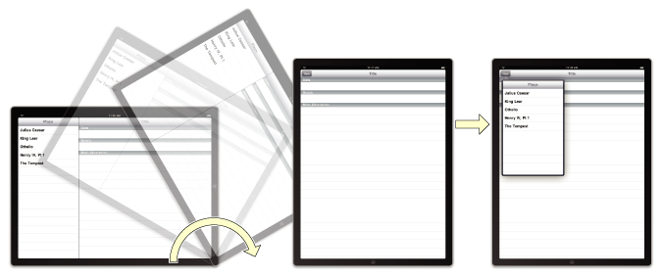
Split View Controllers
The UISplitViewController class is a container view controller that manages two panes of information.
The first pane has a fixed width of 320 points and a height that matches the visible window height. The second pane fills the remaining space.
It is up to you to manage interactions between the two view controllers. However, rotations and other system-related behaviors are managed by the split view controller itself.
You must always install the view from a UISplitViewController object as the root view of your application’s window. The panes of your split view interface may then contain any other type of view controller you need to implement your interface.
Split view controllers cannot be presented modally.

Slide 48
Creating a Split View Controller Using a Storyboard
If you are creating a new Xcode project, the Master-Detail Application template gives you a split view in the storyboard, set as the first scene.
To add a split view controller to an existing app:
Open your application’s main storyboard.
Drag a split view controller out of the library.
Interface Builder creates a split view controller a navigation controller and a view controller, and it creates relationships between them. These relationships identify the newly created view controllers as the left and right panes of the split view controller.
Display it as the first view controller by selecting the option Is Initial View Controller in the Attributes inspector (or present the view controller in your user interface in another way.)
The contents of the two view controllers you embed in the split view are your responsibility. You configure these view controllers just as you would configure any other view controllers in your application. For example, for embedded navigation and tab bar controllers, you may need to specify additional view controller information.

Slide 49
Creating a Split View Controller Programmatically
To create a split view controller programmatically, create a new instance of the UISplitViewController class and assign view controllers to its two properties.
Because its contents are built on-the-fly from the view controllers you provide, you do not have to specify a nib file when creating a split view controller.
Therefore, you can just use the init method to initialize it.
- (BOOL)application:(UIApplication *)application didFinishLaunchingWithOptions:(NSDictionary *)launchOptions {
MyFirstViewController* firstVC = [[MyFirstViewController alloc] init];
MySecondViewController* secondVC = [[MySecondViewController alloc] init];
UISplitViewController* splitVC = [[UISplitViewController alloc] init];
splitVC.viewControllers = [NSArray arrayWithObjects:firstVC, secondVC, nil];
window = [[UIWindow alloc] initWithFrame:[[UIScreen mainScreen] bounds]];
window.rootViewController = splitVC;
[window makeKeyAndVisible];
return YES;
}

Slide 50
Popovers in Details

Slide 51
Popovers
Although not a view controller itself, the UIPopoverController class manages the presentation of view controllers.
You use a popover controller object to present content using a popover, which is a visual layer that floats above your app’s window.
Popovers provide a lightweight way to present or gather information from the user and are commonly used in the following situations:
To display information about an object on the screen
To manage frequently accessed tools or configuration options
To present a list of actions to perform on objects inside one of your views
To present one pane from a split view controller when the device is in a portrait orientation

Slide 52
Creating and Presenting a Popover
The content of a popover is derived from a view controller object that you provide.
Popovers are capable of presenting most types of view controllers.
When you are ready to present that view controller in a popover, do the following:
Create an instance of the UIPopoverController class and initialize it with your view controller object.
Specify the size of the popover, which you can do in one of two ways:
Assign a value to the contentSizeForViewInPopover property of the view controller you want to display in the popover.
Assign a value to the popoverContentSize property of the popover controller itself.
(Optional) Assign a delegate to the popover.
Present the popover.
presentPopoverFromBarButtonItem:permittedArrowDirections:animated: method is a convenient way to present popovers from your app’s toolbar.
You can also associate a popover with a particular part of one of your views using the presentPopoverFromRect:inView:permittedArrowDirections:animated: method.

Slide 53
Presenting a popover programmatically
The popover is stored in a property (defined by the owning class) that maintains a strong reference to the popover object.
The size of the popover is set to the size of the view controller’s view, but the two need not be the same.
Of course, if the two are not the same, you must use a scroll view to ensure the user can see all of the popover’s contents.
Popovers are dismissed automatically when the user taps outside the popover view. You can dismiss it programmatically using the dismissPopoverAnimated: method.
-(IBAction)toolbarItemTapped:(id)sender{
MyViewController* content = [[MyViewController alloc] init];
UIPopoverController* aPopover = [[UIPopoverController alloc] initWithContentViewController:content];
aPopover.delegate = self;
// Store the popover in a custom property for later use.
self.popoverController = aPopover;
[self.popoverController presentPopoverFromBarButtonItem:sender
permittedArrowDirections:UIPopoverArrowDirectionAny animated:YES];
}

Slide 54
Resource Management in View Controllers

Slide 55
Initializing a View Controller
When a view controller is first instantiated, it creates or loads objects it needs through its lifetime. It should not create its view hierarchy or objects associated with displaying content. It should focus on data objects and objects needed to implement its critical behaviors.
Initializing a View Controller Loaded from a Storyboard
When you create a view controller in a storyboard, the attributes you configure in Interface Builder are serialized into an archive. Later, when the view controller is instantiated, this archive is loaded into memory and processed. The archive is loaded by calling the view controller’s initWithCoder: method. Then, the awakeFromNib method is called on any object that implements that method.
Initializing View Controllers Programmatically
If a view controller allocates its resources programmatically, create a custom initialization method that is specific to your view controller. This method should call the super class’s init method and then perform any class specific initialization.
In general, do not write complex initialization methods. Instead, implement a simple initialization method and then provide properties for clients of your view controller to configure its behaviors.

Slide 56
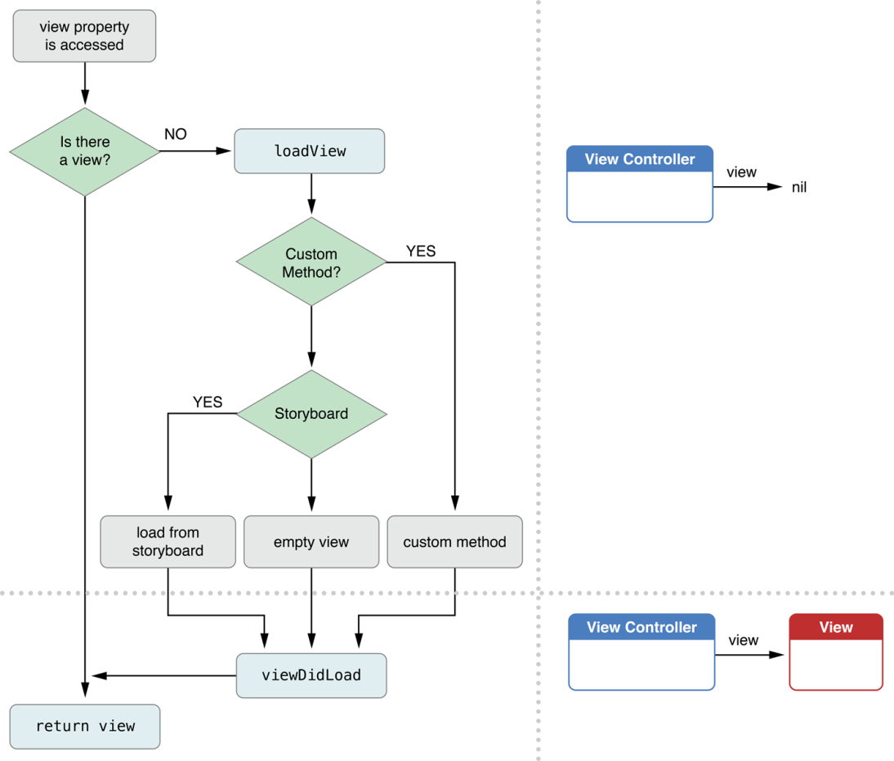
A View Controller Instantiates Its View Hierarchy
Whenever some part of your app asks the view controller for its view object, the view controller loads the view hierarchy into memory and stores it in its view property.
The steps that occur during the load cycle are:
The view controller calls its loadView method. The default implementation of the loadView method does one of two things:
If it is associated with a storyboard, it loads the views from the storyboard.
If it is not associated with a storyboard, an empty UIView object is created and assigned to the view property.
The view controller calls its viewDidLoad method, which enables your subclass to perform any additional load-time tasks.

Slide 57
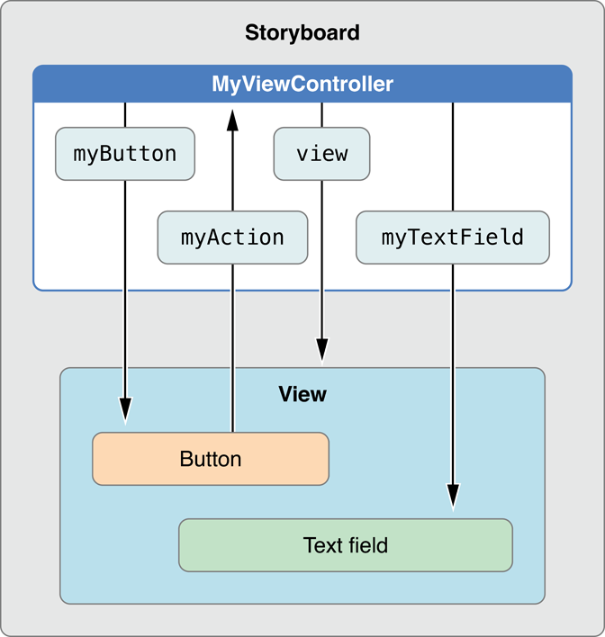
Configuring Actions and Outlets for Your View Controller
Using Interface Builder, you create connections between the views in your interface and your view controller.
Below is shown the declaration of a custom MyViewController class’s two custom outlets (designated by the IBOutlet keyword) and a single action method (designated by the IBAction return type).
The declarations are made in a category inside the implementation file. The outlets store references to a button and a text field in the storyboard, while the action method responds to taps in the button.
@interface MyViewController()
@property (nonatomic) IBOutlet id myButton;
@property (nonatomic) IBOutlet id myTextField;
- (IBAction)myAction:(id)sender;
@end

Slide 58
Creating a View Programmatically
If you prefer to create views programmatically, instead of using a storyboard, you do so by overriding your view controller’s loadView method. Your implementation of this method should do the following:
Create a root view object.
The root view contains all other views associated with your view controller.
You can use a generic UIView object, a custom view you define, or any other view.
Create additional subviews and add them to the root view.
For each view, you should:
Create and initialize the view.
Add the view to a parent view using the addSubview: method.
If you are using auto layout, assign sufficient constraints to each of the views you just created to control the position and size of your views. Otherwise, implement the viewWillLayoutSubviews and viewDidLayoutSubviews methods to adjust the frames of the subviews in the view hierarchy.
Assign the root view to the view property of your view controller.
See the next slide for the code sample

Slide 59
Creating a View Programmatically (end)
(void)loadView{
CGRect applicationFrame = [[UIScreen mainScreen] applicationFrame];
UIView *contentView = [[UIView alloc] initWithFrame:applicationFrame];
contentView.backgroundColor = [UIColor blackColor];
self.view = contentView;
levelView = [[LevelView alloc] initWithFrame:applicationFrame viewController:self];
[self.view addSubview:levelView];
}
Note: When overriding the loadView method to create your views programmatically, you should not call super. Doing so initiates the default view-loading behavior and usually just wastes CPU cycles. Your own implementation of the loadView method should do all the work that is needed to create a root view and subviews for your view controller.

Slide 60
Managing Memory Efficiently
The UIViewController class provides some methods for memory management tasks.
Task | Methods | Discussion
Allocating critical data structures required by your view controller | Initialization methods | Your custom initialization method (whether it is named init or something else) is always responsible for putting your view controller object in a known good state. This includes allocating whatever data structures are needed to ensure proper operation.
Creating your view objects | loadView | Overriding the loadView method is required only if you intend to create your views programmatically.
Creating custom objects | Custom properties and methods | Consider using a pattern similar the loadView method. Create a property that holds the object and a matched method to initialize it.
Allocating or loading data to be displayed in your view | viewDidLoad | Data objects are typically provided by configuring your view controller’s properties. Any additional data objects your view controller wants to create should be done by overriding the viewDidLoad method. By the time this method is called, your view objects are guaranteed to exist and to be in a known good state.
Responding to low-memory notifications | didReceiveMemoryWarning | Use this method to deallocate all noncritical objects associated with your view controller.
Releasing critical data structures required by your view controller | dealloc | Override this method only to perform any last-minute cleanup of your view controller class. Objects stored in instance variables and properties are automatically released; you do not need to release them explicitly.

Slide 61
On iOS 6 and Later, a View Controller Unloads Its Own Views When Desired
The default behavior for a view controller is to load its view hierarchy when the view property is first accessed and thereafter keep it in memory until the view controller is disposed of. However, the system automatically releases these expensive resources when the view is not attached to a window.
You can explicitly release the view hierarchy if that additional memory is necessary for your app.
(void)didReceiveMemoryWarning {
[super didReceiveMemoryWarning];
// 1. Add code to clean up any of your own resources that are no longer necessary.
if ([self.view window] == nil) {
// 2. Add code to preserve data stored in the views that might be needed later.
// 3. Add code to clean up other strong references to the view in the view hierarchy.
self.view = nil;
}
}
The next time the view property is accessed, the view is reloaded exactly as it was the first time.

Slide 62
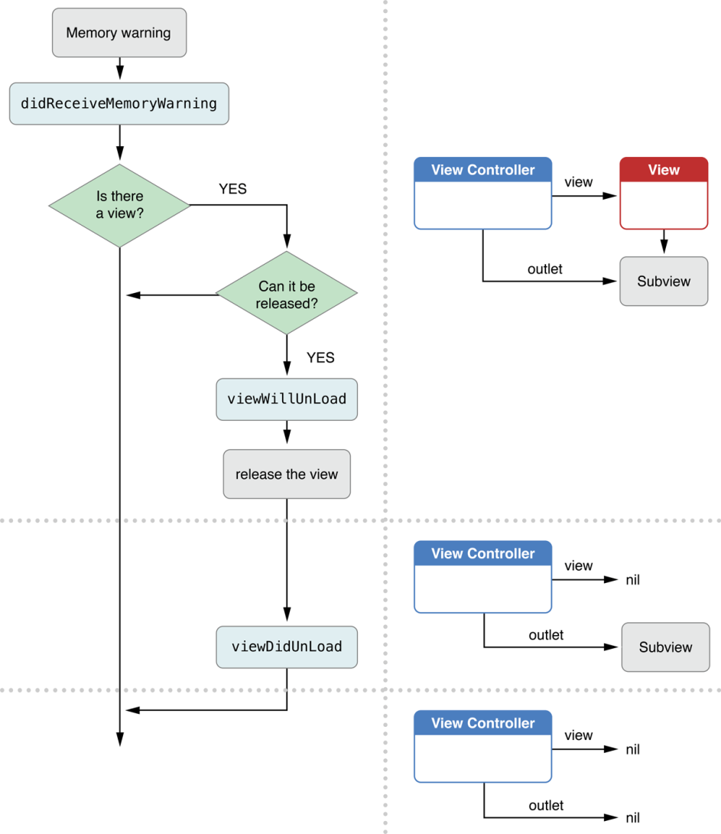
On iOS 5 and Earlier, the System May Unload Views When Memory Is Low
In earlier versions of iOS the steps that occur during the unload cycle are as follows:
The app receives a low-memory warning from the system.
Each view controller calls its didReceiveMemoryWarning method. If you override this method, you should use it to release any memory or objects that your view controller object no longer needs. You must call super at some point in your implementation to ensure that the default implementation runs. On iOS 5 and earlier, the default implementation attempts to release the view. On iOS 6 and later, the default implementation exits.
If the view cannot be safely released (for example, it is visible onscreen), the default implementation exits.
The view controller calls its viewWillUnload method. A subclass typically overrides this method when it needs to save any view properties before the views are destroyed.
It sets its view property to nil.
The view controller calls its viewDidUnload method. A subclass typically overrides this method to release any strong references it has to those views.

Slide 63
Responding to Notifications

Slide 64
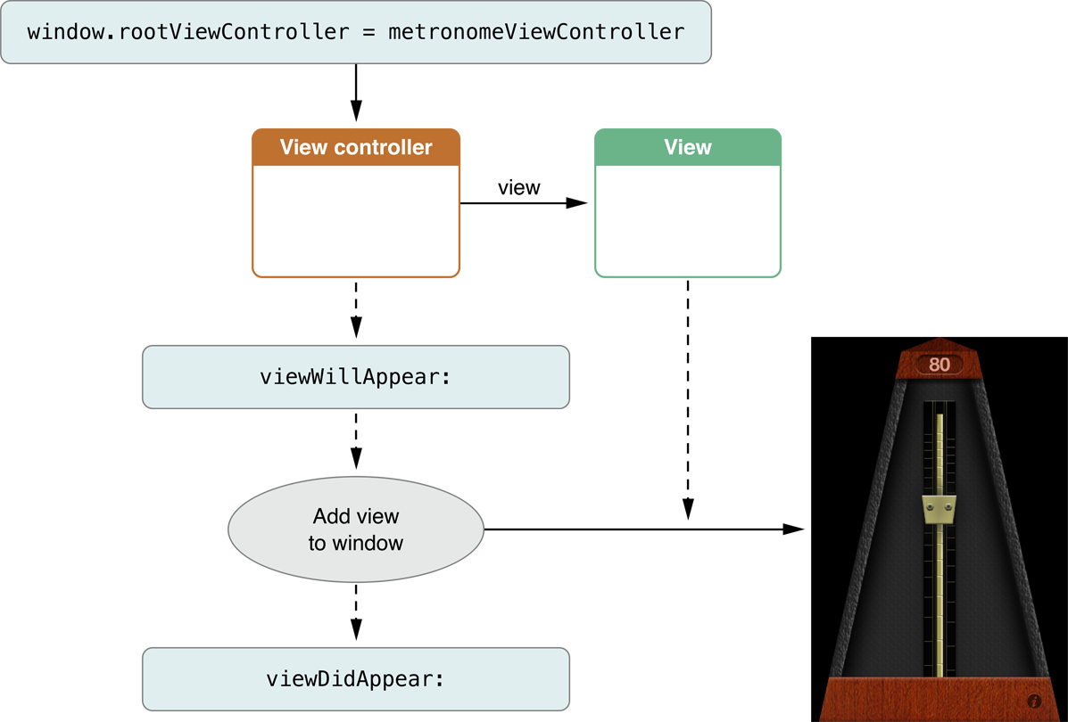
Responding When a View Appears
When the visibility of a view controller’s view changes, the view controller calls some built-in methods to notify subclasses of the changes.
You can override these methods to override how your subclass reacts to the change.
For example, you can use these notifications to change the color and orientation of the status bar so that it matches the presentation style of the view that is about to be displayed.
This figure shows the sequence of events that occurs when a view controller’s view is added to a window’s view hierarchy.

Slide 65
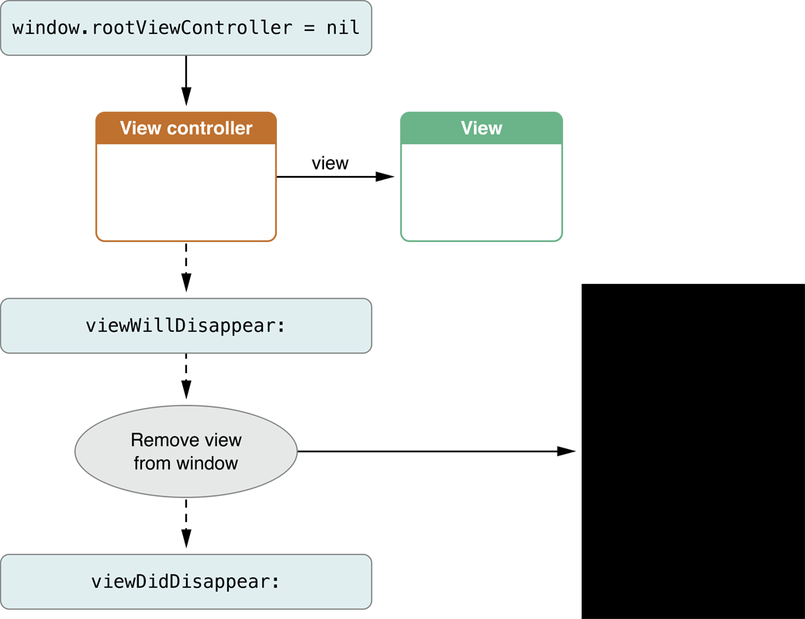
Responding When a View Disappears
This figure shows the sequence of events that occurs when a view is removed from its window.
When the view controller detects that its view is about to be removed or hidden, it calls the viewWillDisappear: and viewDidDisappear: methods to give subclasses a chance to perform any relevant tasks.

Slide 66
Determining Why a View’s Appearance Changed
Occasionally, it can be useful to know why a view is appearing or disappearing.
The UIViewController class provides methods your view controller can call to determine why the appearance change occurred.
These methods can be called from inside your implementation of the viewWillAppear:, viewDidAppear:, viewWillDisappear: and viewDidDisappear: methods.
Method Name | Usage
isMovingFromParentViewController | You call this method to determine if the view controller’s view is being hidden because the view controller was removed from its container view controller.
isMovingToParentViewController | You call this method to determine if the view controller’s view is being shown because the view controller was just added to a container view controller.
isBeingPresented | You call this method to determine if the view controller’s view is being shown because the view controller was just presented by another view controller.
isBeingDismissed | You call this method to determine if the view controller’s view is being hidden because the view controller was just dismissed.

Slide 67
How View Controllers Participate in the View Layout Process
When the size of a view controller’s view changes, its subviews are repositioned to fit the new space available to them. The views in the controller’s view hierarchy perform most of this work themselves through the use of layout constraints and autoresizing masks. However, the view controller is also called at various points so that it can participate in the process. Here’s what happens:
The view controller’s view is resized to the new size.
If autolayout is not in use, the views are resized according to their autoresizing masks.
The view controller’s viewWillLayoutSubviews method is called.
The view’s layoutSubviews method is called. If autolayout is used to configure the view hierarchy, it updates the layout constraints by executing the following steps:
The view controller’s updateViewConstraints method is called.
The UIViewController class’s implementation of the updateViewConstraints method calls the view’s updateConstraints method.
After the layout constraints are updated, a new layout is calculated and the views are repositioned.
The view controller’s viewDidLayoutSubviews method is called.

Slide 68
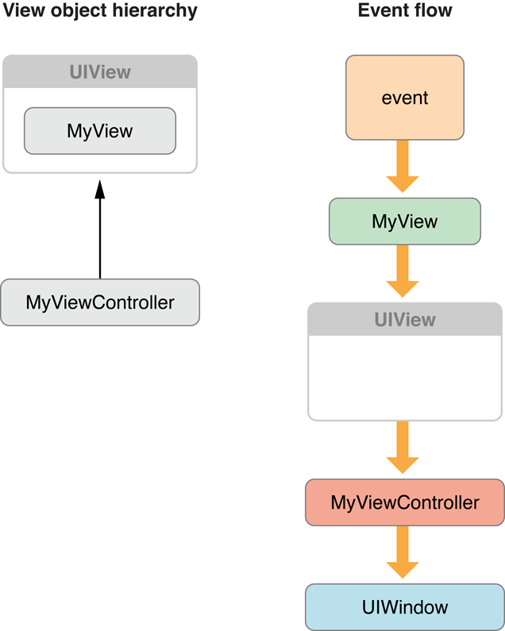
Using View Controllers in the Responder Chain
View controllers are descendants of the UIResponder class and are therefore capable of handling all sorts of events.
When a view does not respond to a given event, it passes that event to its superview, traveling up the view hierarchy all the way to the root view.
However, if any view in the chain is managed by a view controller, it passes the event to the view controller object before passing it up to the superview.
In this way, the view controller can respond to events that are not handled by its views.
If the view controller does not handle the event, that event moves on to the view’s superview as usual.
If the view controller does not handle the event, the event is further passed along to the superview of the generic UIView object, which in this case is the window object.

Slide 69
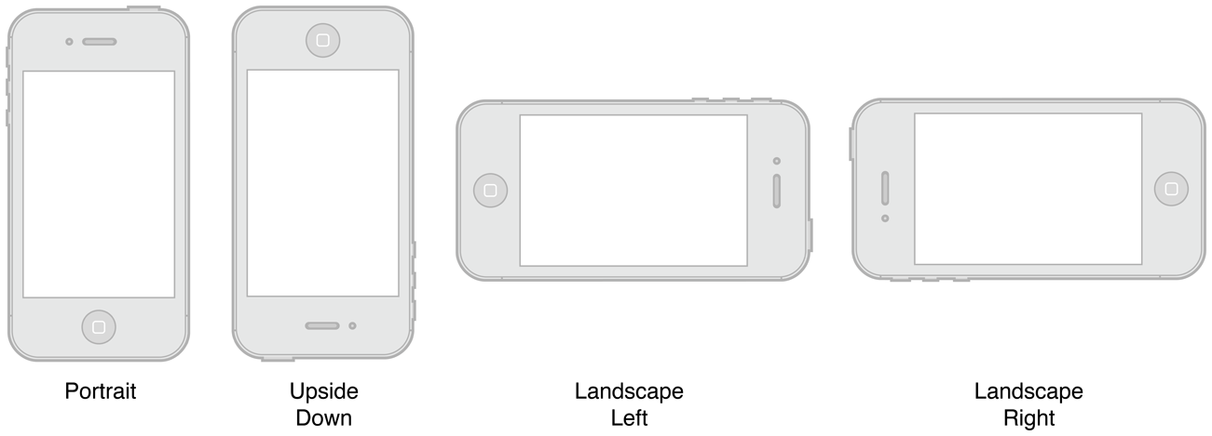
Supporting Multiple Interface Orientations
The accelerometers in iOS–based devices make it possible to determine the current orientation of the device.
By default, an app supports both portrait and landscape orientations.
When the orientation of an iOS–based device changes, the system sends out a UIDeviceOrientationDidChangeNotification notification to let any interested parties know that the change occurred.
By default, the UIKit framework listens for this notification and uses it to update your interface orientation automatically.

Slide 70
Controlling What Interface Orientations Are Supported (iOS 6)
A view controller that acts as the root view controller of the main window or is presented full screen on the main window can declare what orientations it supports. It does this by overriding the supportedInterfaceOrientations method.
If the view controller supports multiple orientations but appears better in a different orientation, you can provide a preferred orientation by overriding the preferredInterfaceOrientationForPresentation method.
The easiest way to set an app’s app’s supported interface orientations is to edit the project’s Info.plist file. As in the case of the view controller, you define which of the four interface orientations are permitted.
- (NSUInteger)supportedInterfaceOrientations {
return UIInterfaceOrientationMaskPortrait | UIInterfaceOrientationMaskLandscapeLeft;
}
- (UIInterfaceOrientation)preferredInterfaceOrientationForPresentation {
return UIInterfaceOrientationLandscapeLeft;
}

Slide 71
Supported Interface Orientations (iOS 5 and earlier)
To declare your supported interface orientations, override the shouldAutorotateToInterfaceOrientation: method and indicate which orientations your view supports.
- (BOOL)shouldAutorotateToInterfaceOrientation:(UIInterfaceOrientation)orientation {
if ((orientation == UIInterfaceOrientationPortrait) || (orientation == UIInterfaceOrientationLandscapeLeft))
return YES;
return NO;
}
Important: You must always return YES for at least one interface orientation.

Slide 72
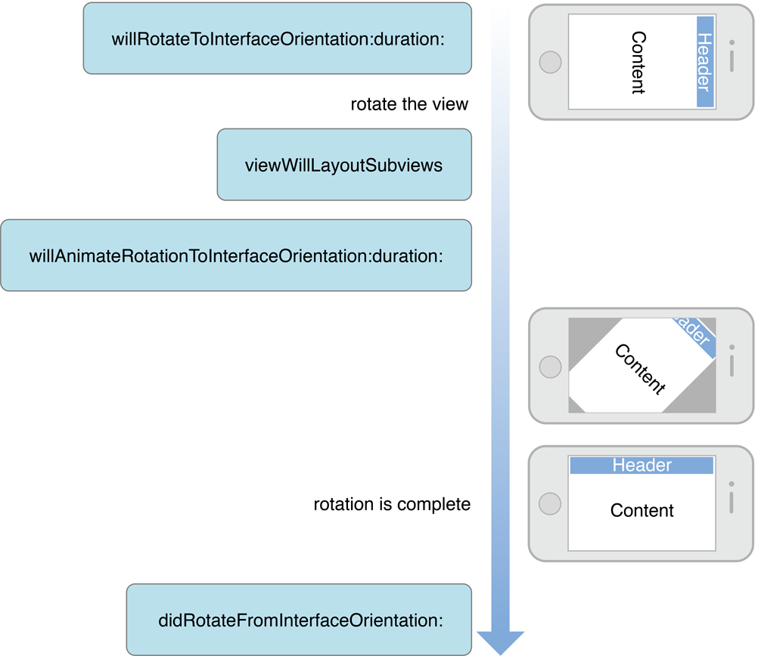
Responding to Orientation Changes
Here is the sequence of events that occur when a rotation is triggered:
The window calls the root view controller’s willRotateToInterfaceOrientation:duration: method.
Container view controllers forward this message on to the currently displayed content view controllers.
The window adjusts the bounds of the view controller’s view. This causes the view to layout its subviews. You can query the app object’s statusBarOrientation property to determine the current user interface layout.
The view controller’s willAnimateRotationToInterfaceOrientation:duration: method is called. This method is called from within an animation block so that any property changes you make are animated at the same time as other animations that comprise the rotation.
The animation is executed.
The window calls the view controller’s didRotateFromInterfaceOrientation: method.
Container view controllers forward this message to the currently displayed content view controllers. This action marks the end of the rotation process. You can use this method to show views, change the layout of views, or make other changes to your app.

Slide 73
Presenting View Controllers

Slide 74
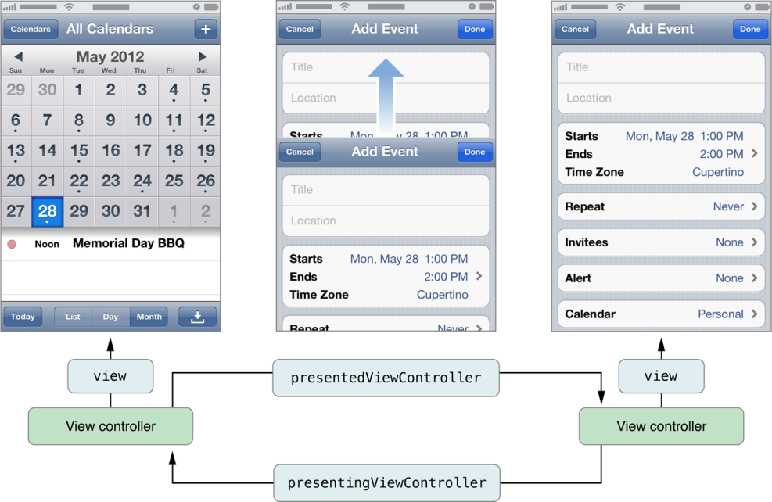
How View Controllers Present Other View Controllers
A presented view controller is not a specific subclass of UIViewController.
Instead, any view controller can be presented by your app. However, like tab bar and navigation controllers, you present view controllers when you want to convey a specific meaning about the relationship between the previous view hierarchy and the newly presented view hierarchy.
When you present a modal view controller, the system creates a relationship between the view controller that did the presenting and the view controller that was presented.
Specifically, the view controller that did the presenting updates its presentedViewController property to point to its presented view controller.
Similarly, the presented view controller updates its presentingViewController property to point back to the view controller that presented it.

Slide 75
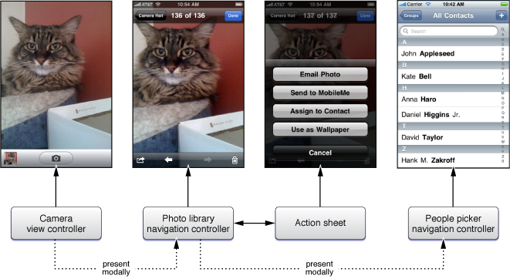
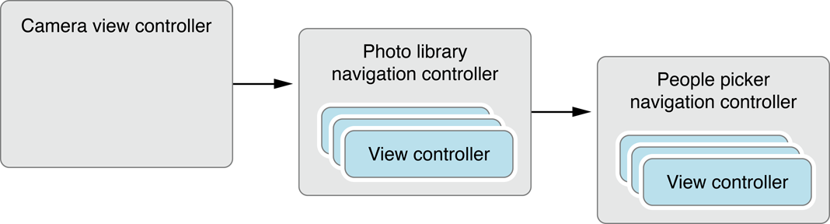
Creating a chain of modal view controllers
Any view controller object can present a single view controller at a time.
This is true even for view controllers that were themselves presented by another view controller.
In other words, you can chain presented view controllers together, presenting new view controllers on top of other view controllers as needed.
When presenting a navigation controller, you always present the UINavigationController object itself, rather than presenting any of the view controllers on its navigation stack.
However, individual view controllers on the navigation stack may present other view controllers, including other navigation controllers.

Slide 76
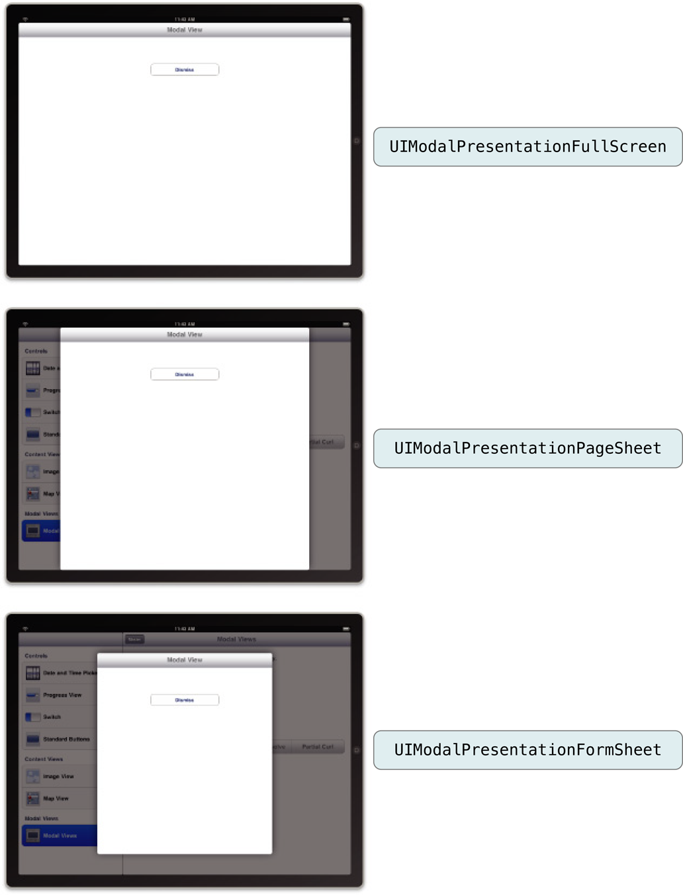
Presentation Styles for Modal Views
For iPad apps, you can present content using several different styles.
In iPhone apps, presented views always cover the visible portion of the window, but when running on an iPad, view controllers use the value in their modalPresentationStyle property to determine their appearance when presented.
Different options for this property allow you to present the view controller so that it fills all or only part of the screen.

Slide 77
Presenting a View Controller
When a view controller is presented using a storyboard segue, it is automatically instantiated and presented.
If you need to present a view controller programmatically, you must do the following:
Create the view controller you want to present.
Set the modalTransitionStyle property of the view controller to the desired value.
Assign a delegate object to the view controller. Typically, the delegate is the presenting view controller. The delegate is used by the presented view controllers to notify the presenting view controller when it is ready to be dismissed. It may also communicate other information back to the delegate.
Call the presentViewController:animated:completion: method of the current view controller, passing in the view controller you want to present.
The presentViewController:animated:completion: method presents the view for the specified view controller object and configures the presenting-presented relationships between the new view controller and the current view controller.

Slide 78
Transition Style
Unless you are restoring your app to some previous state, you usually want to animate the appearance of the new view controller. The transition style you should use depends on how you plan to use the presented view controller.
Transition style | Usage
UIModalTransitionStyleCoverVertical | For this style of transition, content view controllers should provide buttons to dismiss the view controller explicitly. Typically, these are a Done button and an optional Cancel button. If you do not explicitly set a transition style, this style is used by default.
UIModalTransitionStyleFlipHorizontal | The most common usage for this style is to display settings that might change frequently, such as in the Stocks and Weather apps. These settings can be meant for the entire app or they can be specific to the current screen. For this style of transition, you usually provide some sort of button to return the user to the normal running mode of your app.
UIModalTransitionStyleCrossDissolve | Use this style to present an alternate interface when the device changes orientations. In such a case, your app is responsible for presenting and dismissing the alternate interface in response to orientation change notifications. Media-based apps can also use this style to fade in screens displaying media content.

Slide 79
Presenting a view controller programmatically
This listing shows how to present a view controller programmatically.
When the user adds a new recipe, the app prompts the user for basic information about the recipe by presenting a navigation controller.
A navigation controller was chosen so that there would be a standard place to put a Cancel and Done button. Using a navigation controller also makes it easier to expand the new recipe interface in the future. All you would have to do is push new view controllers on the navigation stack.
- (void)add:(id)sender {
// Create the root view controller for the navigation controller
// The new view controller configures a Cancel and Done button for the navigation bar.
RecipeAddViewController *addController = [[RecipeAddViewController alloc] init];
// Configure the RecipeAddViewController. In this case, it reports any changes to a custom delegate object.
addController.delegate = self;
// Create the navigation controller and present it.
UINavigationController *navigationController = [[UINavigationController alloc]
initWithRootViewController:addController];
[self presentViewController:navigationController animated:YES completion: nil];
}

Slide 80
Presenting Standard System View Controllers
A number of standard system view controllers are designed to be presented by your app. Interactions with the system view controllers typically take place through a delegate object.
Each system view controller defines a corresponding protocol, whose methods you implement in your delegate object. Each delegate usually implements a method to either accept whatever item was selected or cancel the operation. Your delegate object should always be ready to handle both cases.
One of the most important things the delegate must do is dismiss the presented view controller by calling the dismissModalViewControllerAnimated: method of the view controller that did the presenting.
Framework | View controllers
Address Book UI | ABNewPersonViewController ABPeoplePickerNavigationController ABPersonViewController ABUnknownPersonViewController
Event Kit UI | EKEventEditViewController EKEventViewController
Game Kit | GKAchievementViewController GKLeaderboardViewController GKMatchmakerViewController GKPeerPickerController GKTurnBasedMatchmakerViewController
Message UI | MFMailComposeViewController MFMessageComposeViewController
Media Player | MPMediaPickerController MPMoviePlayerViewController
UIKit | UIImagePickerController UIVideoEditorController

Slide 81
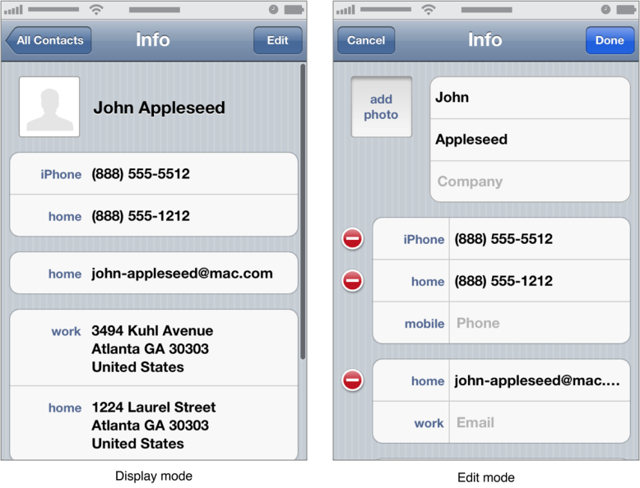
Enabling Edit Mode in a View Controller
To allow a custom view controller class to be used to both display and edit content, override the setEditing:animated: method. Your implementation of this method should add, hide, and adjust the view controller’s views to match the specified mode.
- (void)setEditing:(BOOL)flag animated:(BOOL)animated {
[super setEditing:flag animated:animated];
if (flag == YES) {
// Change views to edit mode.
} else {
// Save the changes and change the views to noneditable.
}
}
A common place in which to use an editable view is in a navigation interface. When implementing your navigation interface, you can include a special Edit button in the navigation bar when your editable view controller is visible. (You can get this button by calling the editButtonItem method of your view controller.) When tapped, this button automatically toggles between an Edit and Done button and calls your view controller’s setEditing:animated: method with appropriate values.

Slide 82
Creating Custom Segues
Segue objects are instances of UIStoryboardSegue or one of its subclasses. Your app never creates segue objects directly; they are always created on your behalf by iOS when a segue is triggered. Here’s what happens:
The destination controller is created and initialized.
The segue object is created and its initWithIdentifier:source:destination: method is called. The identifier is the unique string you provided for the segue in Interface Builder, and the two other parameters represent the two controller objects in the transition.
The source view controller’s prepareForSegue:sender: method is called.
The segue object’s perform method is called. This method performs a transition to bring the destination view controller on-screen.
The reference to the segue object is released, causing it to be deallocated.
To implement a custom segue, you subclass UIStoryboardSegue and implement the two methods: initWithIdentifier:source:destination: and perform
- (void)perform {
// Add your own animation code here.
[[self sourceViewController] presentModalViewController:[self destinationViewController] animated:NO];
}

Slide 83
View and Window Architecture

Slide 84
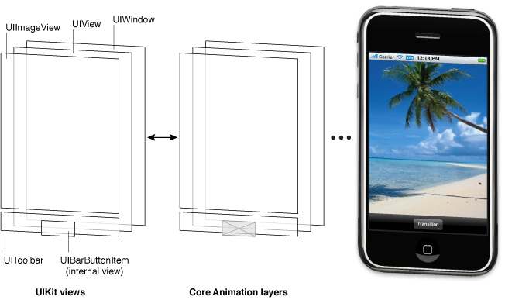
View Architecture Fundamentals
A view object (instance of the UIView) defines a rectangular region on the screen and handles the drawing and touch events in that region.
Views work in conjunction with Core Animation layers (usually an instance of the CALayer class) to handle the rendering and animating of a view’s content. Most operations you perform should be through the UIView interface. However, in situations where you need more control over the rendering or animation behavior of your view, you can perform operations through its layer instead.
The views in the example include a window (which is also a view), a generic UIView object that acts as a container view, an image view, a toolbar for displaying controls, and a bar button item (which is not a view itself but which manages a view internally). Every view has a corresponding layer object that can be accessed from that view’s layer property. (Because a bar button item is not a view, you cannot access its layer directly.) Behind those layer objects are Core Animation rendering objects and ultimately the hardware buffers used to manage the actual bits on the screen.
The actual drawing code of a view object is called as little as possible, and when the code is called, the results are cached by Core Animation and reused as much as possible later.

Slide 85
The View Drawing Cycle
The UIView class uses an on-demand drawing model for presenting content.
When a view first appears on the screen, the system asks it to draw its content.
The system captures a snapshot of this content and uses that snapshot as the view’s visual representation.
When the contents of your view change, you do not redraw those changes directly. Instead, you invalidate the view using either the setNeedsDisplay or setNeedsDisplayInRect: method. These methods tell the system that the contents of the view changed and need to be redrawn at the next opportunity.
Note: Changing a view’s geometry does not automatically cause the system to redraw the view’s content. The view’s contentMode property determines how changes to the view’s geometry are interpreted.
System views typically implement private drawing methods to render their content.
For custom UIView subclasses, you typically override the drawRect: method of your view and use that method to draw your view’s content.

Slide 86
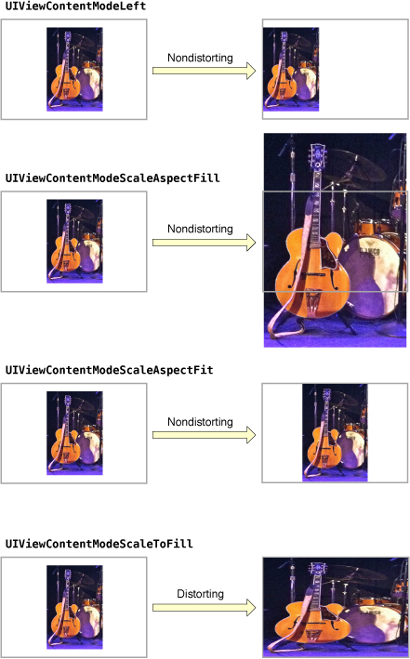
Content Modes
When a view is first displayed, it renders its content as usual and the results are captured in an underlying bitmap.
After that, changes to the view’s geometry do not always cause the bitmap to be recreated. Instead, the value in the contentMode property determines whether the bitmap should be scaled to fit the new bounds or simply pinned to one corner or edge of the view.
The content mode of a view is applied whenever you do the following:
Change the width or height of the view’s frame or bounds rectangles.
Assign a transform that includes a scaling factor to the view’s transform property.
you can also set the content mode to the UIViewContentModeRedraw value when you specifically want your custom views to redraw themselves during scaling and resizing operations.

Slide 87
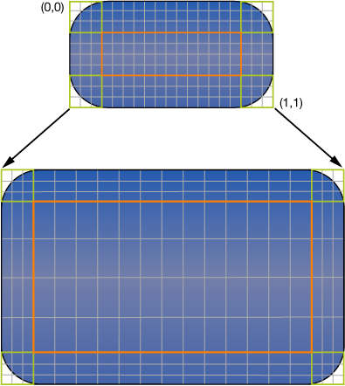
Stretchable Views
You can designate a portion of a view as stretchable so that when the size of the view changes only the content in the stretchable portion is affected.
The stretchable area you specify can allow for stretching along one or both axes of the view.
You specify the stretchable area of a view using the contentStretch property.
This property accepts a rectangle whose values are normalized to the range 0.0 to 1.0. When stretching the view, the system multiplies these normalized values by the view’s current bounds and scale factor to determine which pixel or pixels need to be stretched.
Stretchable areas are only used when the content mode would cause the view’s content to be scaled. This means that stretchable views are supported only with the UIViewContentModeScaleToFill, UIViewContentModeScaleAspectFit, and UIViewContentModeScaleAspectFill content modes.

Slide 88
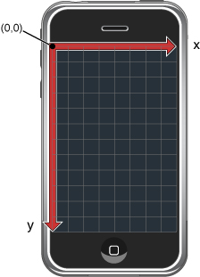
View Geometry and Coordinate Systems
The default coordinate system in UIKit has its origin in the top-left corner and has axes that extend down and to the right from the origin point.
Coordinate values are represented using floating-point numbers, which allow for precise layout and positioning of content regardless of the underlying screen resolution.
In addition to the screen coordinate system, windows and views define their own local coordinate systems that allow you to specify coordinates relative to the view or window origin instead of relative to the screen.
Because every view and window defines its own local coordinate system, you need to be aware of which coordinate system is in effect at any given time.
In the case of drawing, you specify coordinates relative to the view’s own coordinate system. In the case of geometry changes, you specify coordinates relative to the superview’s coordinate system.
The UIWindow and UIView classes both include methods to help you convert from one coordinate system to another.

Slide 89
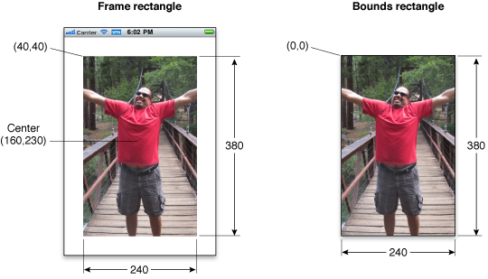
Frame, Bounds, and Center Properties
The frame property contains the frame rectangle, which specifies the size and location of the view in its superview’s coordinate system.
The bounds property contains the bounds rectangle, which specifies the size of the view (and its content origin) in the view’s own local coordinate system.
The center property contains the known center point of the view in the superview’s coordinate system.
Although you can change the frame, bounds, and center properties independent of the others, changes to one property affect the others in the following ways:
When you set the frame property, the size value in the bounds property changes to match the new size of the frame rectangle. The value in the center property similarly changes to match the new center point of the frame rectangle.
When you set the center property, the origin value in the frame changes accordingly.
When you set the size of the bounds property, the size value in the frame property changes to match the new size of the bounds rectangle.

Slide 90
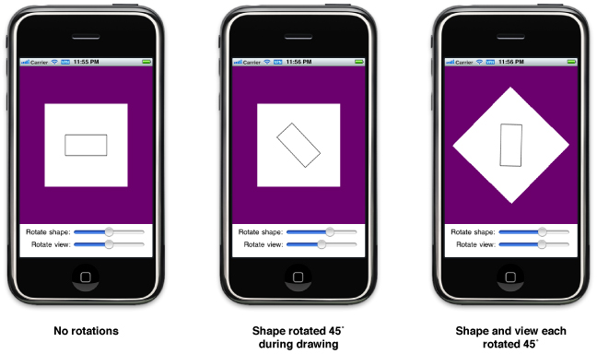
Coordinate System Transformations
An affine transform is a mathematical matrix that specifies how points in one coordinate system map to points in a different coordinate system. You can apply affine transforms to your entire view to change the size, location, or orientation of the view relative to its superview.
To modify your entire view, modify the affine transform in the transform property of your view.
To modify specific pieces of content in your view’s drawRect: method, modify the affine transform associated with the active graphics context.
You can retrieve the affine transform associated with a graphics context using the CGContextGetCTM function and you can use the related Core Graphics functions to set or modify this transform during drawing.
The current transformation matrix (CTM) is the affine transform in use at any given time.
When you modify a view’s transform property, that change affects the view and all of its subviews.

Slide 91
View Properties
Properties | Usage
alpha, hidden, opaque | The alpha and hidden properties change the view’s opacity directly. The opaque property tells the system how it should composite your view.
bounds, frame, center, transform | These properties affect the size and position of the view. The center and frame properties represent the size and position of the view relative to its parent view. The bounds property defines the view’s visible content area in its own coordinate system. The transform property is used to animate or move the entire view in complex ways.
autoresizingMask, autoresizesSubviews | The autoresizingMask property controls how a view responds to changes in its parent view’s bounds. The autoresizesSubviews property controls whether the current view’s subviews are resized at all.
contentMode, contentStretch, contentScaleFactor | The contentMode and contentStretch properties determine how the content is treated when the view’s width or height changes. The contentScaleFactor property is used only when you need to customize the drawing behavior of your view for high-resolution screens.
gestureRecognizers, userInteractionEnabled, multipleTouchEnabled, exclusiveTouch | The gestureRecognizers property contains gesture recognizers attached to the view. The other properties control what touch events the view supports.
backgroundColor, subviews, drawRect: method, layer, (layerClass method) | For simple views, you can set a background color and add one or more subviews. The subviews property itself contains a read-only list of subviews, but there are several methods for adding and rearranging subviews. For views with custom drawing behavior, you must override the drawRect: method. For more advanced content, you can work directly with the view’s Core Animation layer. To specify an entirely different type of layer for the view, you must override the layerClass method.

Slide 92

View Hierarchy
Interface Builder is the most convenient way to build view hierarchies because you assemble your views graphically, see the relationships between the views, and see exactly how those views will appear at runtime.
If you prefer to create your views programmatically instead, you create and initialize them and then use the following methods to arrange them into hierarchies:
To add a subview to a parent, call the addSubview: method of the parent view.
To insert a subview in the middle of the parent’s list of subviews, call any of the insertSubview:... methods of the parent view.
To reorder existing subviews inside their parent, call the bringSubviewToFront:, sendSubviewToBack:, or exchangeSubviewAtIndex:withSubviewAtIndex: methods of the parent view. Using these methods is faster than removing the subviews and reinserting them.
To remove a subview from its parent, call the removeFromSuperview method of the subview.

Slide 93

Translating, Scaling, and Rotating Views
Every view has an associated affine transform that you can use to translate, scale, or rotate the view’s content.
The transform property of UIView contains a CGAffineTransform structure with the transformations to apply.
By default, this property is set to the identity transform, which does not modify the appearance of the view.
When applying multiple transformations to a view, the order in which you add those transformations to the CGAffineTransform structure is significant.
Rotating the view and then translating it is not the same as translating the view and then rotating it.
// M_PI/4.0 is one quarter of a half circle, or 45 degrees.
CGAffineTransform xform = CGAffineTransformMakeRotation(M_PI/4.0);
self.view.transform = xform;

Slide 94

Converting Coordinates in the View Hierarchy
The UIView class defines the following methods for converting coordinates to and from the view’s local coordinate system:
convertPoint:fromView:
convertRect:fromView:
convertPoint:toView:
convertRect:toView:
The convert...:fromView: methods convert coordinates from some other view’s coordinate system to the local coordinate system (bounds rectangle) of the current view.
Conversely, the convert...:toView: methods convert coordinates from the current view’s local coordinate system (bounds rectangle) to the coordinate system of the specified view.
If you specify nil as the reference view for any of the methods, the conversions are made to and from the coordinate system of the window that contains the view.

Slide 95

Handling Layout Changes Using Autoresizing Rules
The autoresizesSubviews property of the superview determines whether the subviews resize at all.
If this property is set to YES, the view uses the autoresizingMask property of each subview to determine how to size and position that subview.
Size changes to any subviews trigger similar layout adjustments for their embedded subviews.
The easiest way to configure autoresizing rules is using the Autosizing controls in the Size inspector of Interface Builder.

Slide 96
Responding to Events
View objects are responder objects—instances of the UIResponder class—and are therefore capable of receiving touch events.
You can create the gesture recognizer (to detect taps, swipes, pinches, and other types of common touch-related gestures), assign an appropriate target object and action method to it, and install it on your view using the addGestureRecognizer: method. The gesture recognizer then calls your action method when the corresponding gesture occurs.
If you prefer to handle touch events directly, you can implement the following methods for your view: touchesBegan:withEvent:, touchesMoved:withEvent:, touchesEnded:withEvent:, touchesCancelled:withEvent:
- (void)viewDidLoad {
[super viewDidLoad];
UITapGestureRecognizer *tapRecognizer = [[UITapGestureRecognizer alloc] initWithTarget:self
action:@selector(respondToTapGesture:)];
tapRecognizer.numberOfTapsRequired = 1;
[self.view addGestureRecognizer:tapRecognizer];
}

Slide 97
Animations

Slide 98
Both UIKit and Core Animation provide support for animations, but the level of support provided by each technology varies.
In UIKit, animations are performed using UIView objects. Views support a basic set of animations that cover many common tasks.
Property | Changes you can make
frame | Change the view’s size and position relative to its superview’s coordinate system.
bounds | Change the view’s size.
center | Change the view’s position relative to its superview’s coordinate system.
transform | Scale, rotate, or translate the view relative to its center point. Transformations using this property are always performed in 2D space. (To perform 3D transformations, you must animate the view’s layer object using Core Animation.)
alpha | Gradually change the transparency of the view.
backgroundColor | Change the view’s background color.
contentStretch | Way the view’s contents are stretched to fill the available space.

Slide 99
Animating Property Changes in a View
In order to animate changes to a property of the UIView class, you must wrap those changes inside an animation block.
In iOS 4 and later, you use the block-based class methods to initiate animations.
There are several block-based methods that offer different levels of configuration for the animation block. These methods are:
animateWithDuration:animations:
animateWithDuration:animations:completion:
animateWithDuration:delay:options:animations:completion:
Because these are class methods, the animation blocks you create with them are not tied to a single view.
Thus, you can use these methods to create a single animation that involves changes to multiple views.
[UIView animateWithDuration:1.0 animations:^{
firstView.alpha = 0.0;
secondView.alpha = 1.0;
}];

Slide 100
Completion handler block
If you want to change the default animation parameters, you must use the animateWithDuration:delay:options:animations:completion: method to perform your animations.
This method lets you customize the following animation parameters:
The delay to use before starting the animation
The type of timing curve to use during the animation
The number of times the animation should repeat
Whether the animation should reverse itself automatically when it reaches the end
Whether touch events are delivered to views while the animations are in progress
Whether the animation should interrupt any in-progress animations or wait until those are complete before starting
Another thing that both the animateWithDuration:animations:completion: and animateWithDuration:delay:options:animations:completion: methods support is the ability to specify a completion handler block.
You might use a completion handler to signal your application that a specific animation has finished. Completion handlers are also the way to link separate animations together.
See the complete code on the next slide

Slide 101
Using a completion handler
Creating an animation block with custom options
- (IBAction)showHideView:(id)sender{
// Fade out the view right away
[UIView animateWithDuration:1.0 delay: 0.0 options: UIViewAnimationOptionCurveEaseIn
animations:^{ thirdView.alpha = 0.0; }
completion:^(BOOL finished) {
// Wait one second and then fade in the view
[UIView animateWithDuration:1.0 delay: 1.0 options:UIViewAnimationOptionCurveEaseOut
animations:^{ thirdView.alpha = 1.0; } completion:nil];
}
];
}
Important: Changing the value of a property while an animation involving that property is already in progress does not stop the current animation. Instead, the current animation continues and animates to the new value you just assigned to the property.

Slide 102
Nesting Animation Blocks
You can assign different timing and configuration options to parts of an animation block by nesting additional animation blocks. As the name implies, a nested animation block is a new animation block created inside an existing animation block.
Nested animations are started at the same time as any parent animations but run (for the most part) with their own configuration options. By default, nested animations do inherit the parent’s duration and animation curve but even those options can be overridden as needed.
[UIView animateWithDuration:1.0 delay: 1.0 options:UIViewAnimationOptionCurveEaseOut animations:^{
aView.alpha = 0.0;
// Create a nested animation that has a different duration, timing curve, and configuration.
[UIView animateWithDuration:0.2 delay:0.0 options: UIViewAnimationOptionOverrideInheritedCurve |
UIViewAnimationOptionCurveLinear | UIViewAnimationOptionOverrideInheritedDuration |
UIViewAnimationOptionRepeat | UIViewAnimationOptionAutoreverse animations:^{
[UIView setAnimationRepeatCount:2.5];
anotherView.alpha = 0.0;
} completion:nil
];
} completion:nil];

Slide 103
Changing the Subviews of a View
Changing the subviews of a view allows you to make moderate changes to the view.
By the time the animations finish, the same view is displayed but its contents are now different.
In iOS 4 and later, you use the transitionWithView:duration:options:animations:completion: method to initiate a transition animation for a view.
Limiting animations to showing, hiding, adding, or removing subviews allows the view to create a snapshot image of the before and after versions of the view and animate between the two images, which is more efficient.
You can include the UIViewAnimationOptionAllowAnimatedContent option when calling the method. Including that option prevents the view from creating snapshots and animates all changes directly.
- (IBAction)displayNewPage:(id)sender {
[UIView transitionWithView:self.view duration:1.0
options:UIViewAnimationOptionTransitionCurlUp
animations:^{
currentTextView.hidden = YES;
swapTextView.hidden = NO;
} completion:^(BOOL finished) {
// Save the old text and then swap the views.
[self saveNotes:temp];
UIView* temp = currentTextView;
currentTextView = swapTextView;
swapTextView = temp;
}
];
}

Slide 104
Replacing a View with a Different View
Replacing views technique swaps only views (and not view controllers), you are responsible for designing your application’s controller objects appropriately. This technique is simply a way of presenting new views quickly using some standard transitions.
In iOS 4 and later, you use the transitionFromView:toView:duration:options:completion: method to transition between two views. This method actually removes the first view from your hierarchy and inserts the other. If you want to hide views instead of remove them from your view hierarchy, pass the UIViewAnimationOptionShowHideTransitionViews key as one of the options.
- (IBAction)toggleMainViews:(id)sender {
[UIView transitionFromView:(displayingPrimary ? primaryView : secondaryView)
toView:(displayingPrimary ? secondaryView : primaryView) duration:1.0
options:(displayingPrimary ? UIViewAnimationOptionTransitionFlipFromRight :
UIViewAnimationOptionTransitionFlipFromLeft)
completion:^(BOOL finished) {
if (finished) { displayingPrimary = !displayingPrimary; }
}
];
}

Slide 105
Questions?

